Slide 1
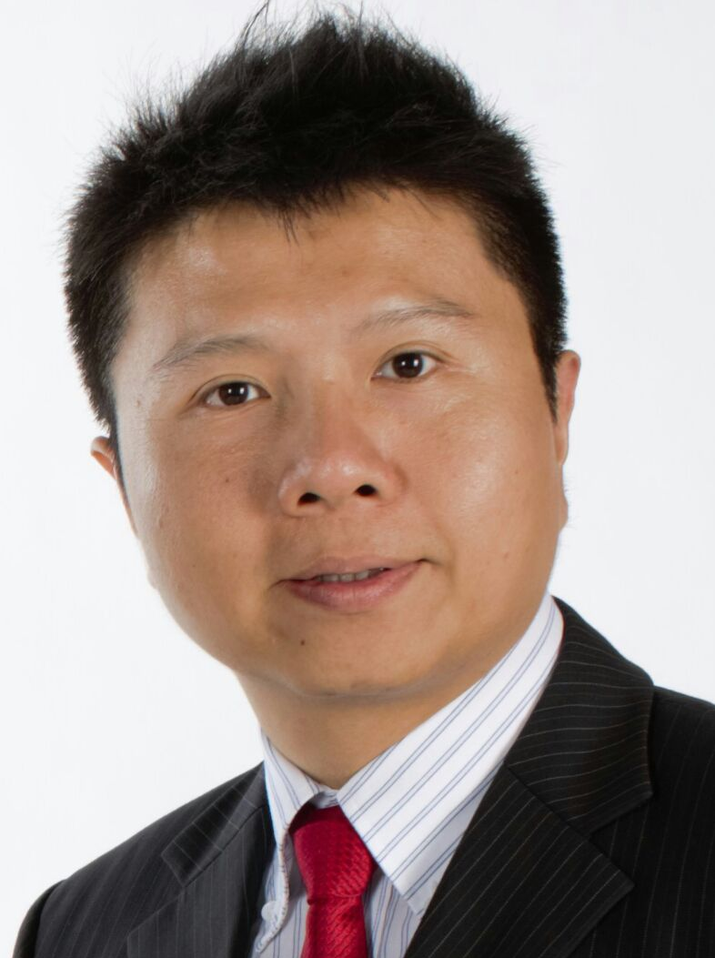

超連鎖事業帳戶與HK.SHOP.COM的優化功能
New enhancements on UnFranchise.com and HK.SHOP.COM
Calvin Chiang
總顧問經理級
National Supervising Coordinator
四個佣金週期共賺取HK$76,600
HK$76,600 in 4 Commission weeks
本簡報中提到的收入等級純屬舉例說明，無意代表美安香港超連鎖™店主的一般收入，也無意表示任何超連鎖™店主皆可賺取同等收入。美安香港超連鎖™店主的成功與否，取決於其在發展事業時的努力、才能與投入程度。
The income levels mentioned in the following presentation are for illustration purposes only. They are not intended to represent the income of a typical Market Hong Kong UnFranchise ™Owner, nor are they intended to represent that any given Independent UnFranchise ™ Owner will earn income in that amount. The success of any Market Hong Kong Independent UnFranchise ™ Owner will depend upon the amount of hard work, talent, and dedication which he or she devotes to building his or her Market Hong Kong Business.

Slide 2
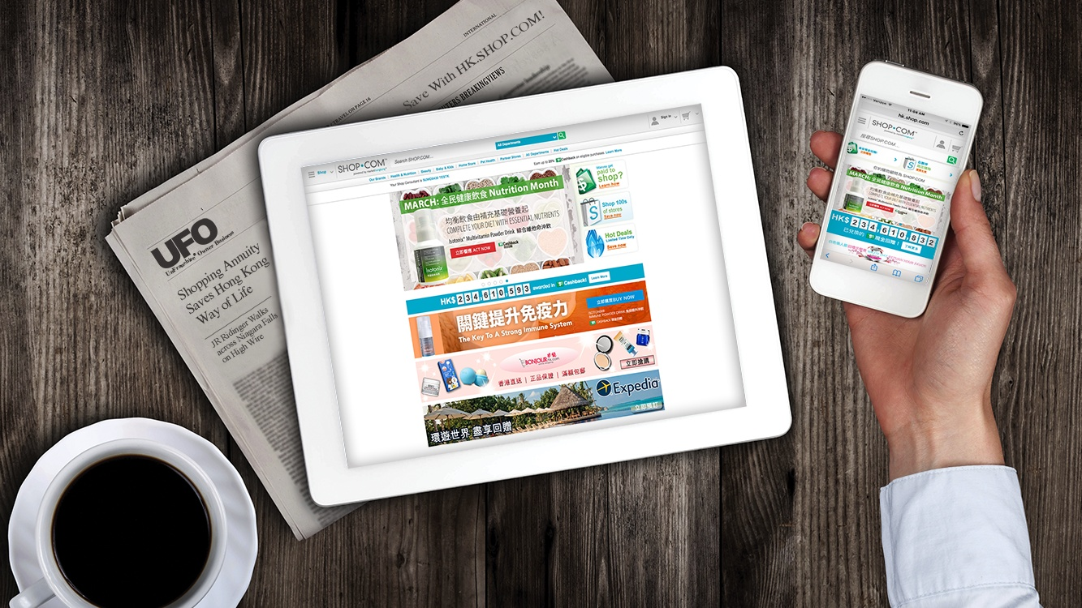
[
]
THE UNFRANCHISE™ BUSINESS
Copyright © 2017 Market America Worldwide

Slide 3



A GLOBAL PRODUCT BROKERAGE AND INTERNET MARKETING
COMPANY THAT SPECIALIZES IN ONE-TO-ONE MARKETING
2013 Torch Award Winner
Trust • Performance • Integrity
BBB of Central NC
GREENSBORO, NC

Slide 4

(1:1 marketing) is a customer relationship management strategy emphasizing personalized interactions with customers.

Slide 5




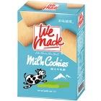


Marketing Trends
One to One Marketing
Focus on Customer Share
Mass Marketing
Focus on Market Share
Sell one product to more customers
Tech
Sell more products to one customer
Notes:
一對一行銷重視的是「顧客佔有率」，而大眾行銷尊崇的是「市場佔有率」。市場佔有率是以產品為中心，要把一種產品賣給市場上更多的顧客；顧客佔有率則是以顧客為中心，要把更多的產品賣給同一位顧客。顧客佔有率是指對顧客終身消費總額的佔有率，爭取同一位顧客一生都使用你的產品，甚至發掘顧客一生中各個階段的消費潛能。

Slide 6
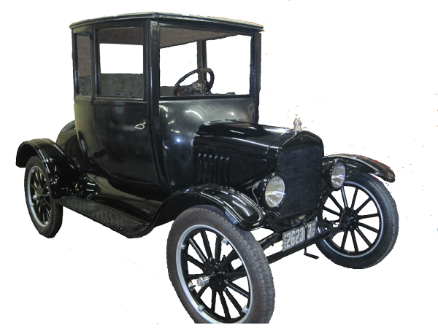
Ford Model T

Slide 7
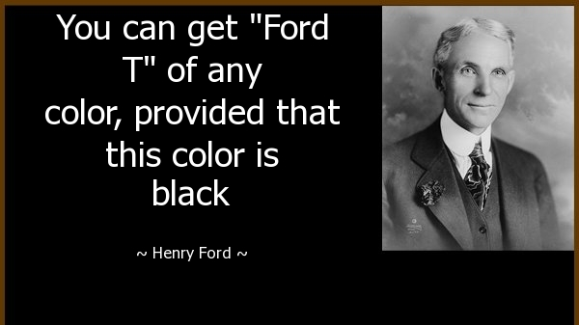

Slide 8
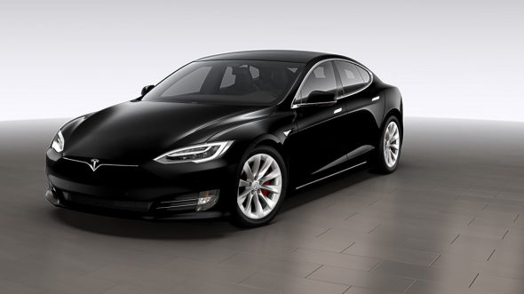
Tesla Model S

Slide 9
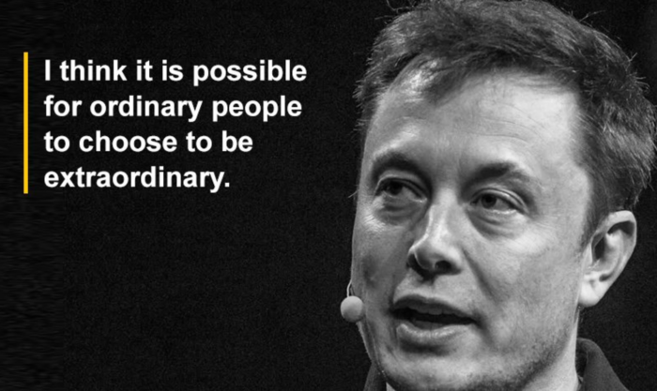

Slide 10

Technology allows people to control their own life

Slide 11
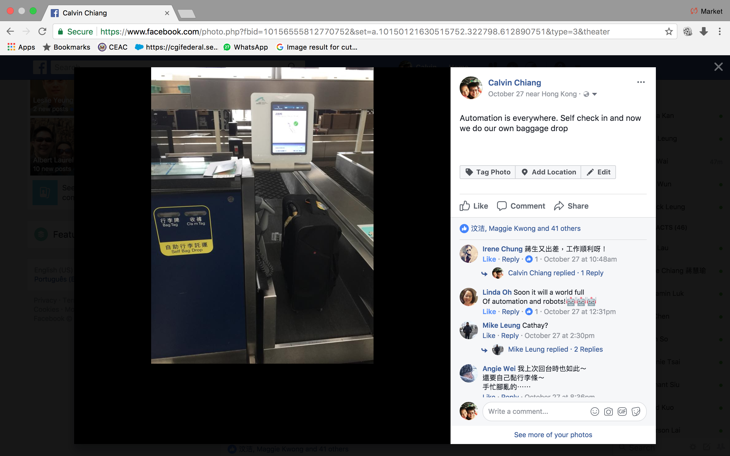

Slide 12
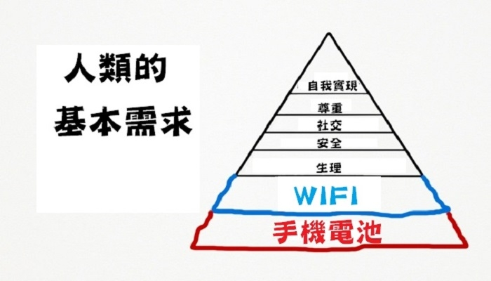
Self actualization
Esteem
Social Life
Safety
Basic needs of a human
Physiological
Phone battery

Slide 13

The key to run an UnFranchise Business is to continue to implement the Basic 5

Slide 14
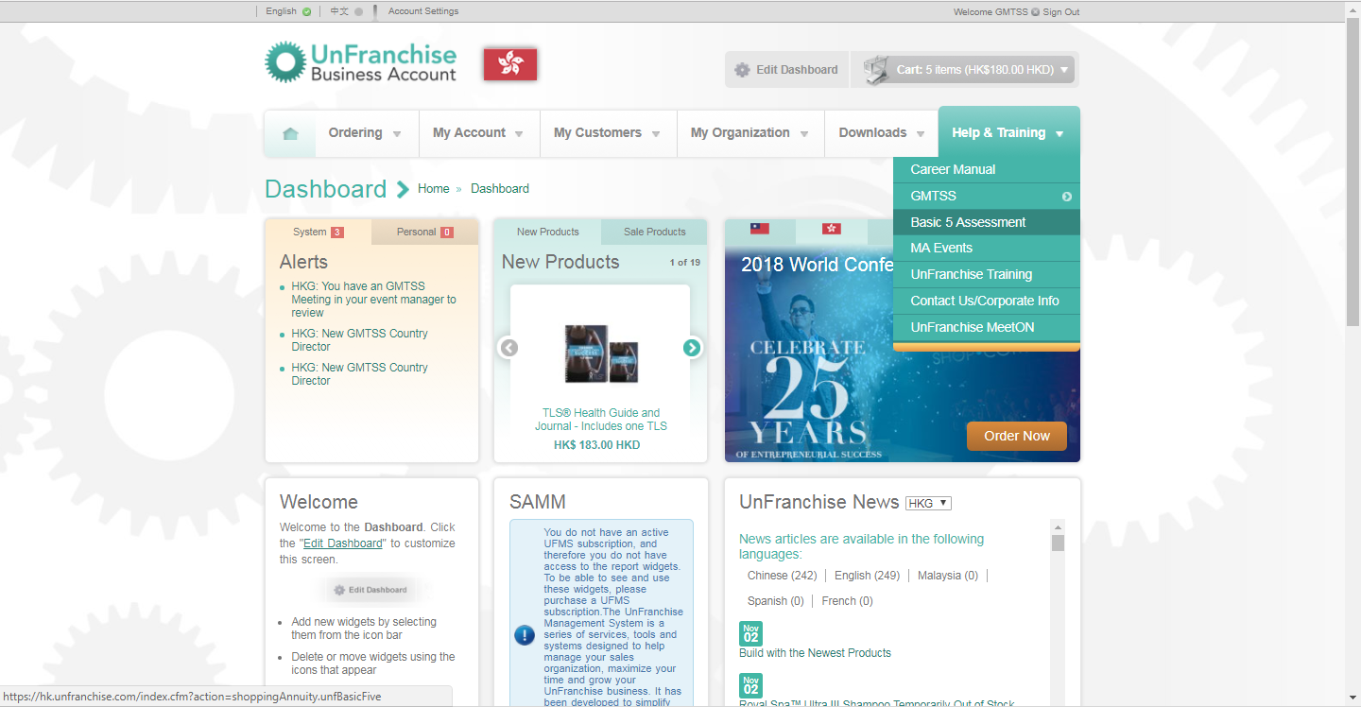
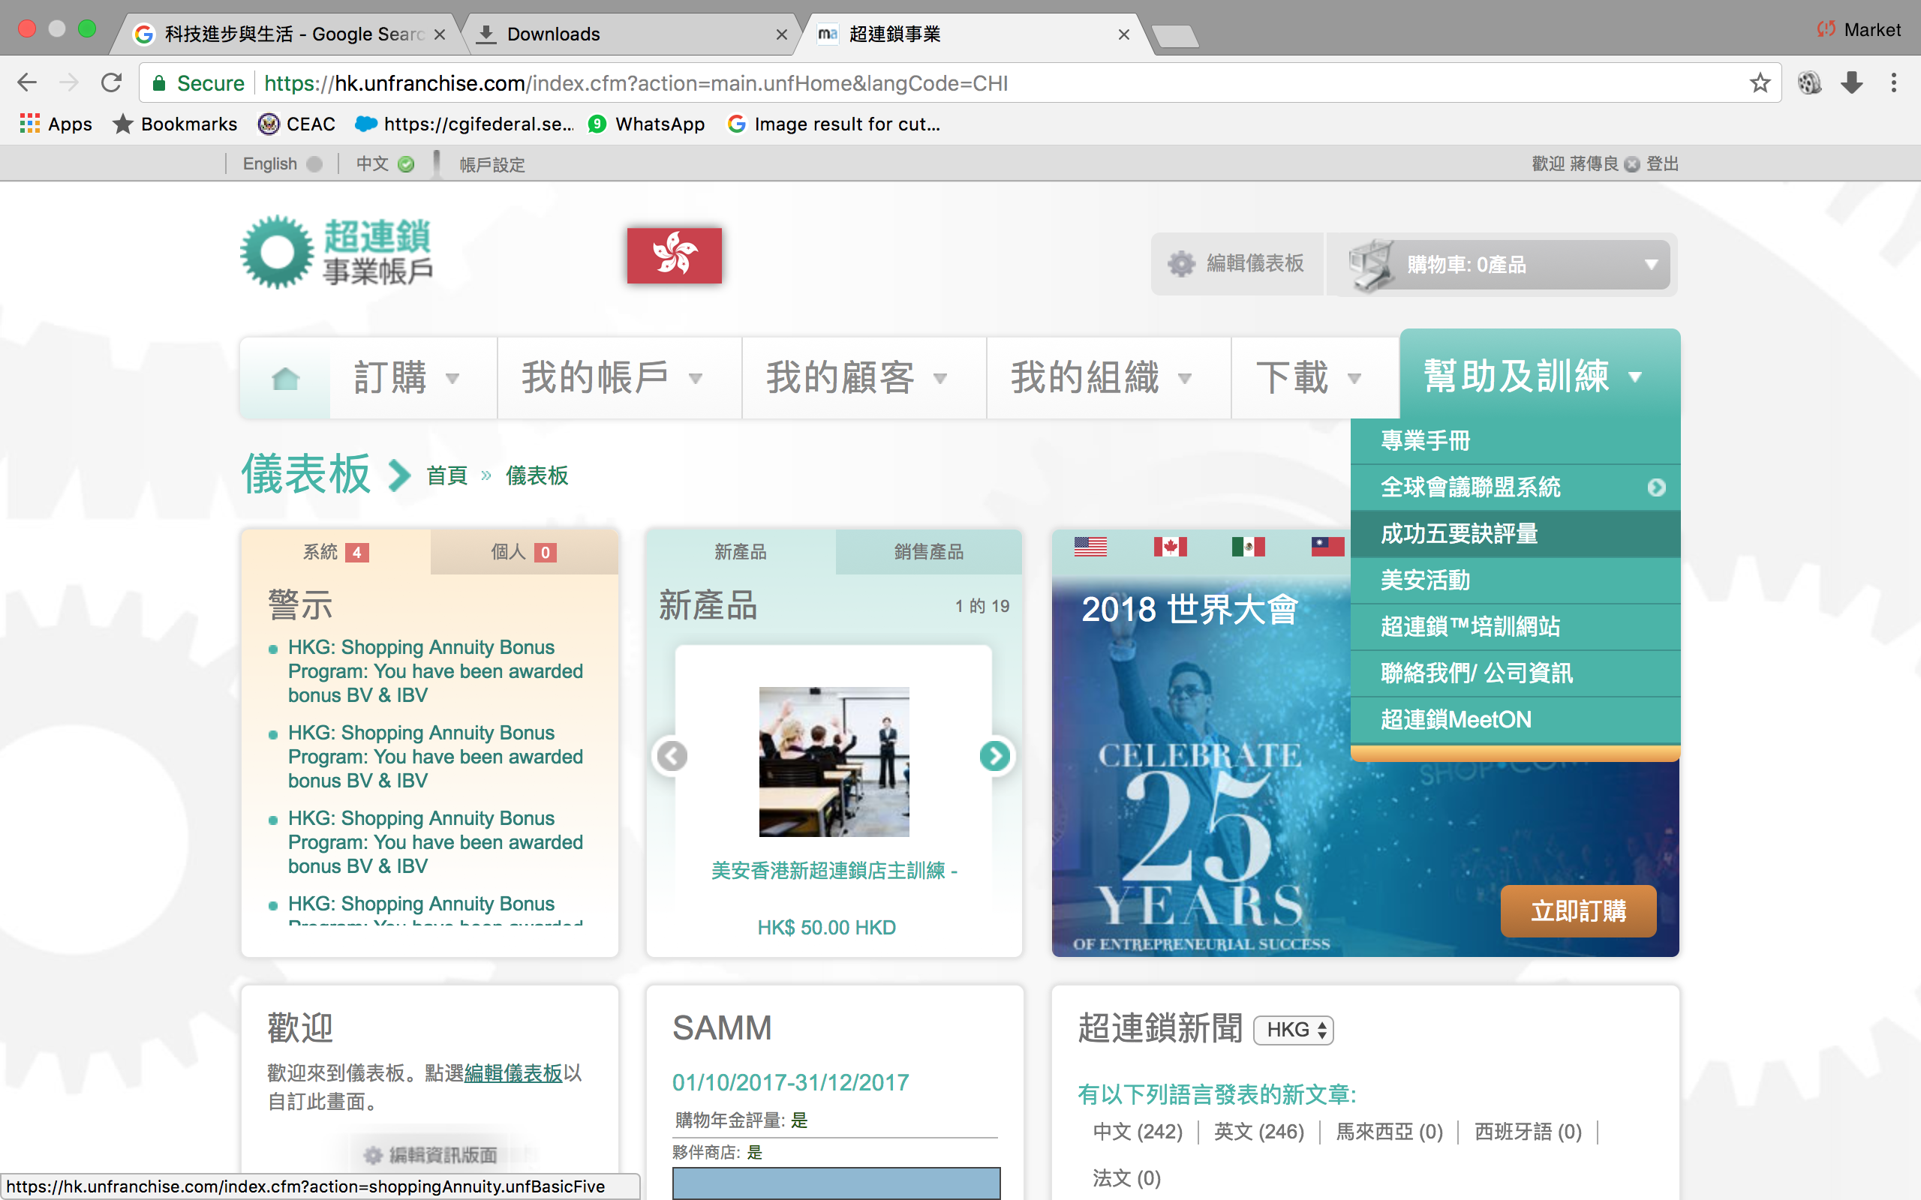

Slide 15
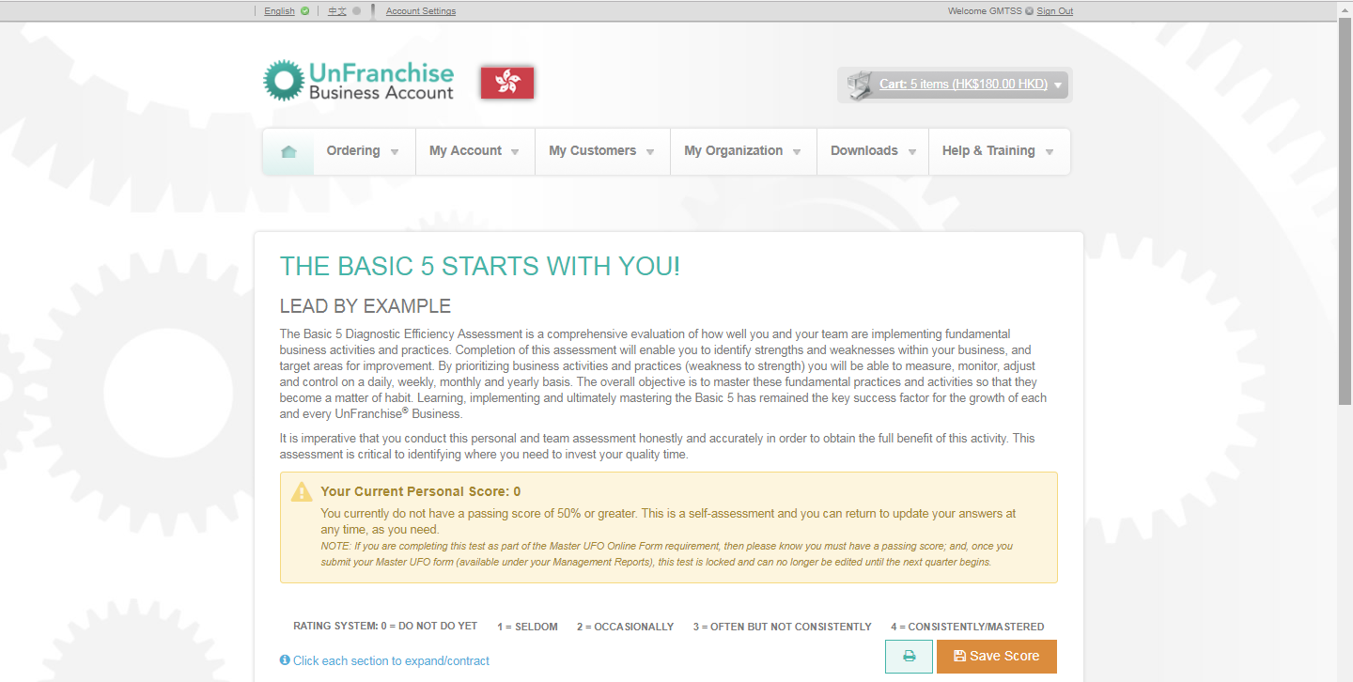
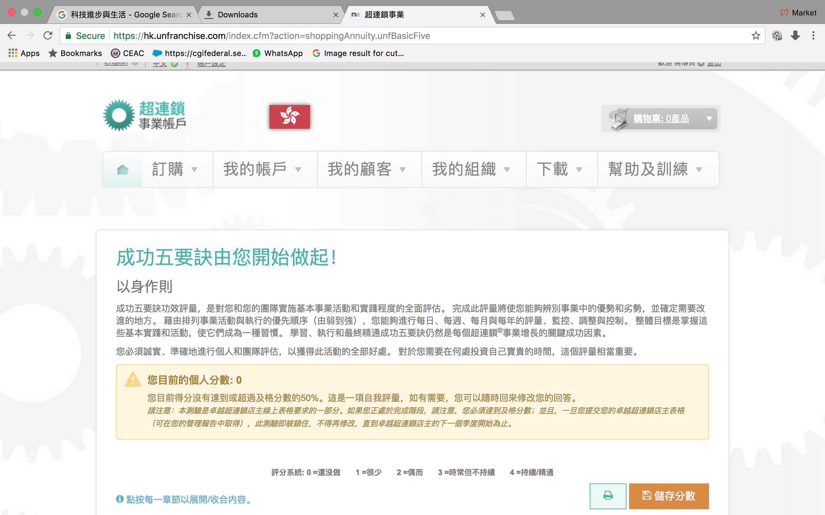

Slide 16
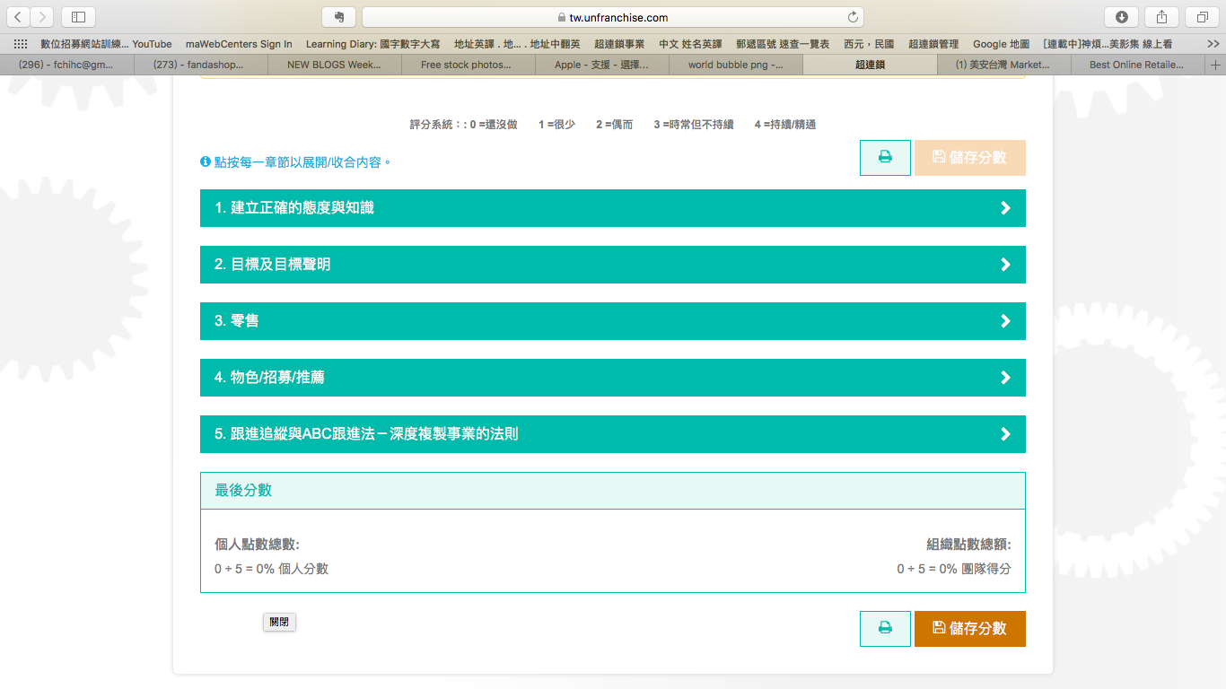
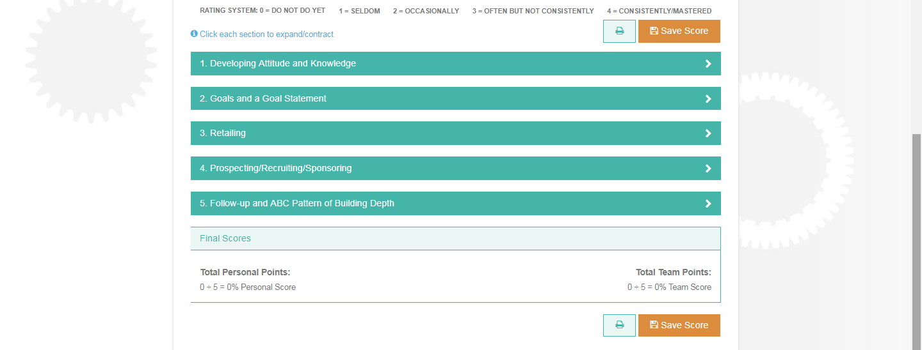
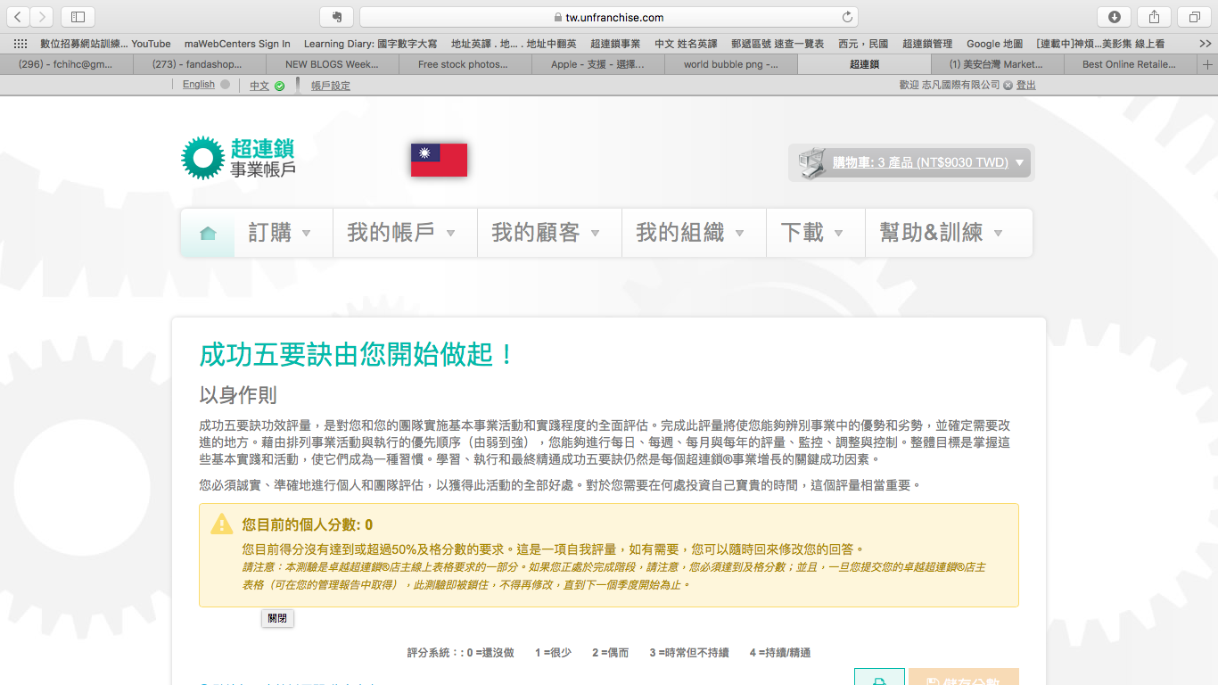

Slide 17
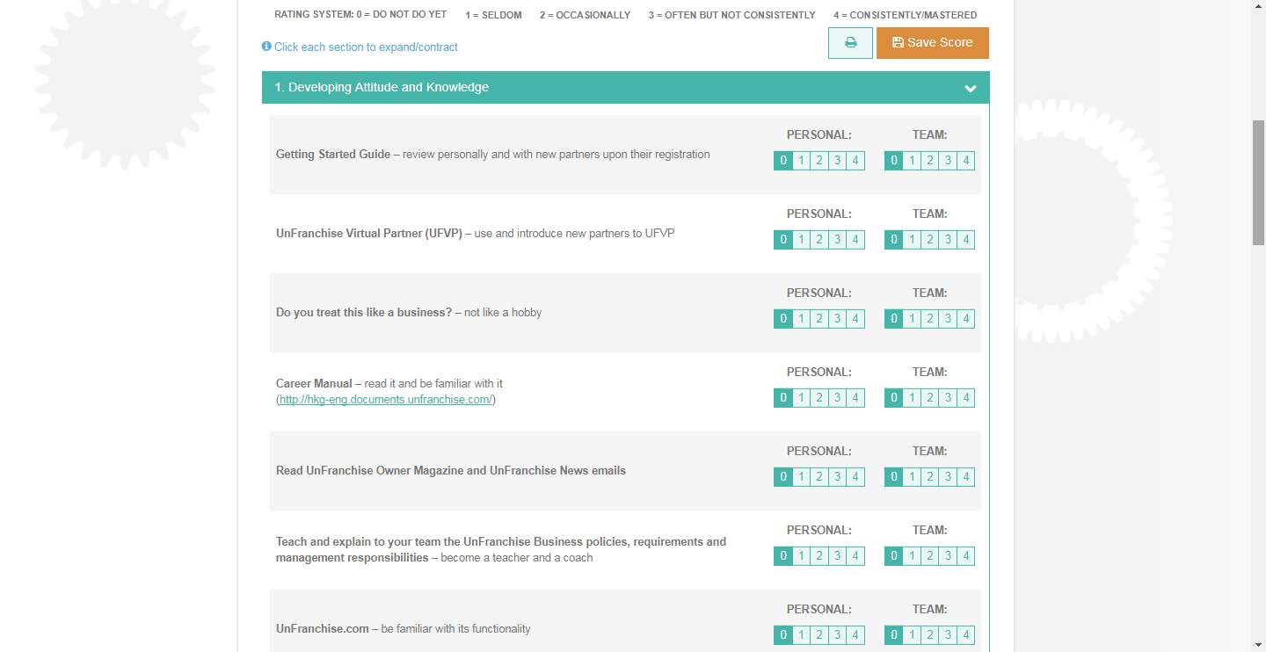
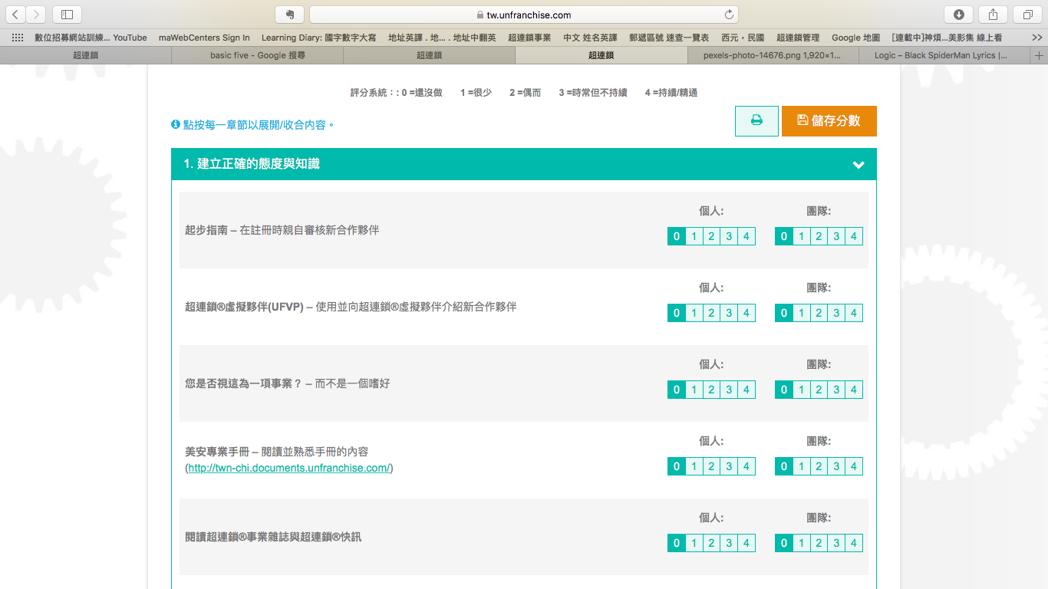
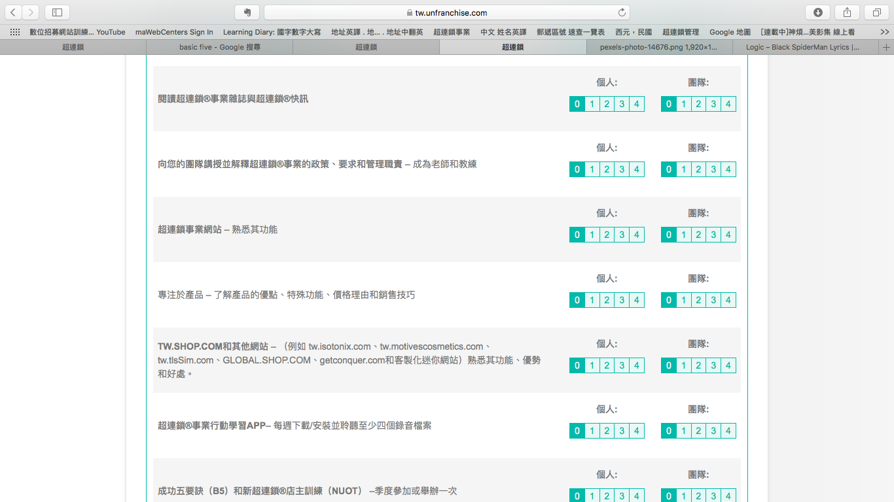
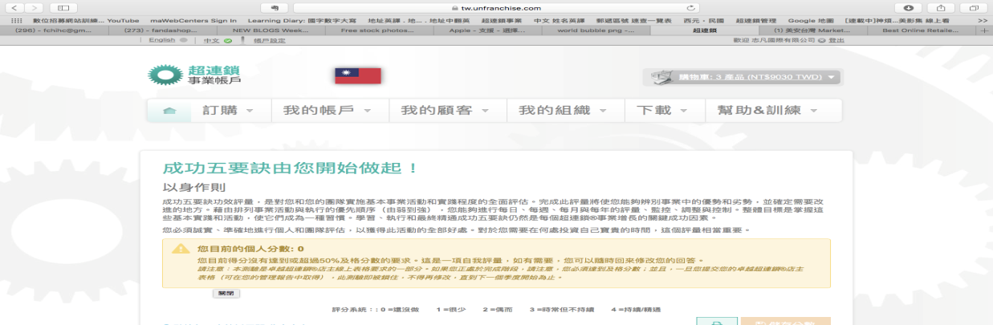

Slide 18


Slide 19

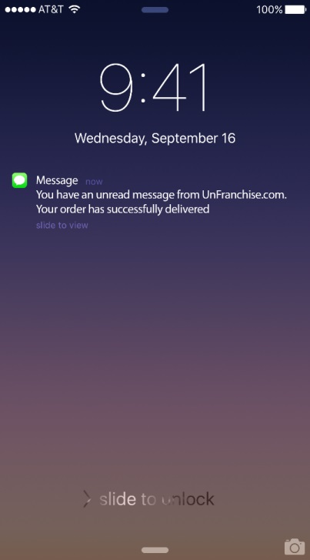
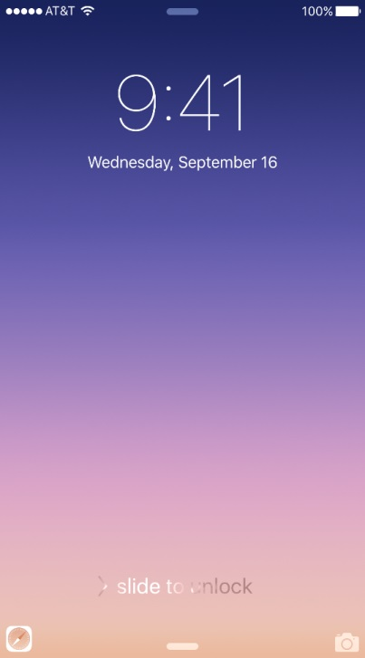
Text Message
Notifications
Sent directly to your phone

Slide 20
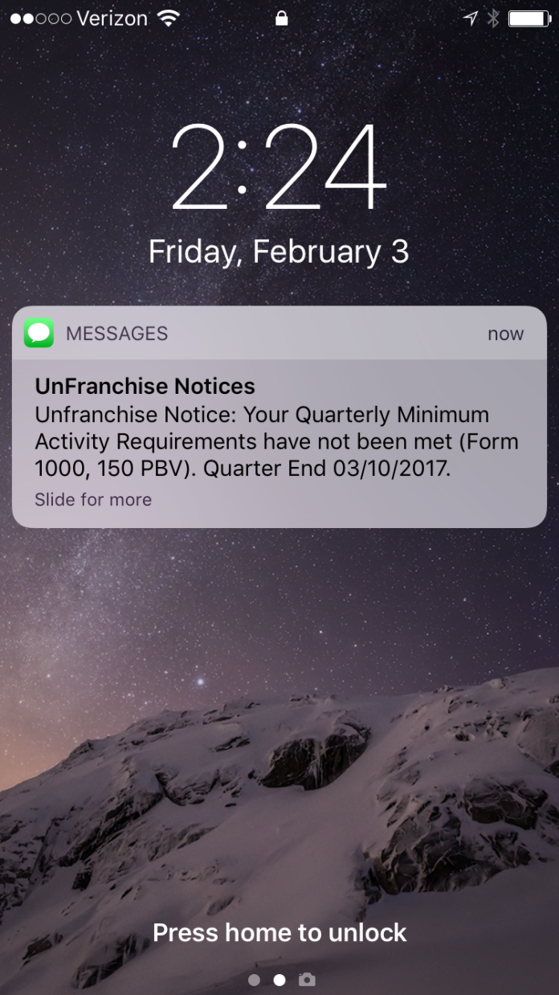

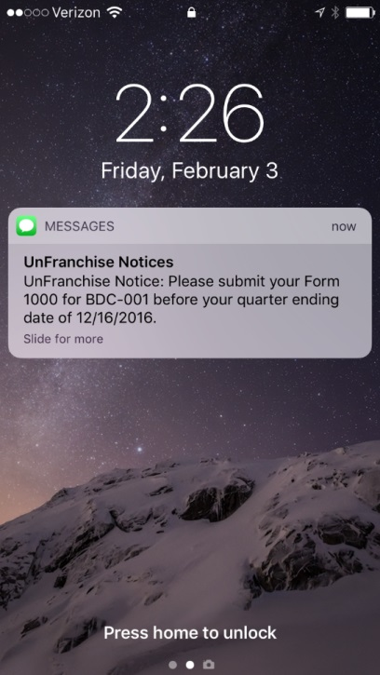
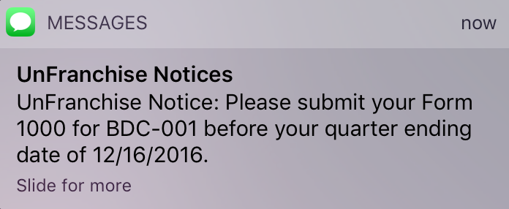
Haven’t turned in
your
Form 1000

Slide 21
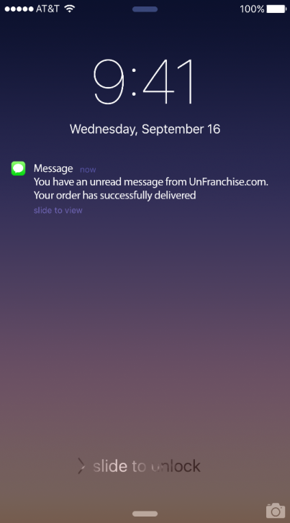
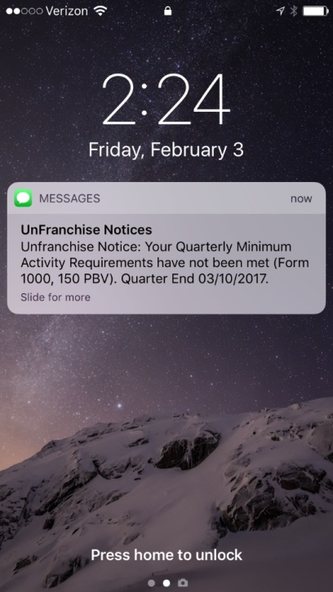

Haven’t met your
Quarterly
Qualification

Slide 22
Notifications
Available
Newly Registered Customer
New Partner waiting to be placed.

Slide 23
New
notifications
Annual Renewal Reminder to Up-line
Credit card is about to expire
BV Available to assign

Slide 24



Slide 25

We’ve shown you text messaging, but let me show you something new!

Slide 26



TEXT
INTERACTIONS

Slide 27

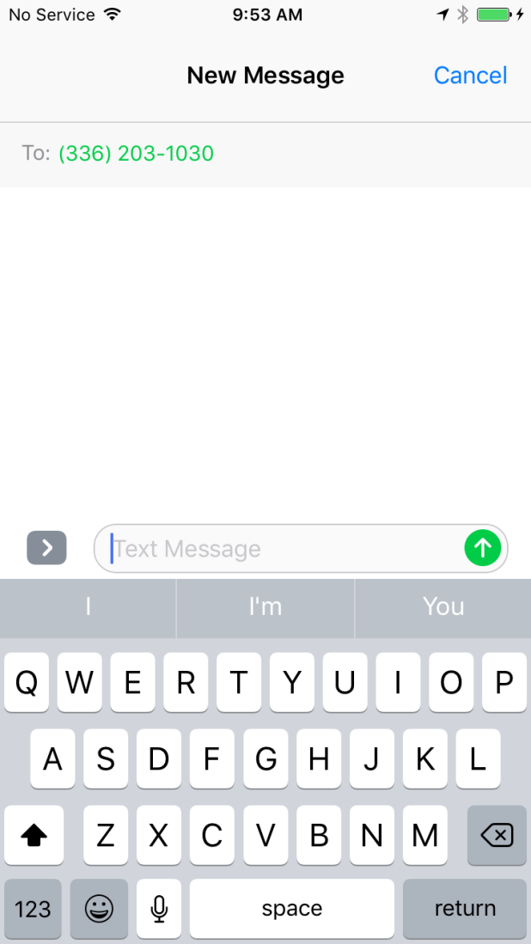
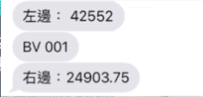



Now Live
SMS Interactions
Quickly get BV and IBV Sales volume totals in a simple text message!
BV 001
Text:
BV 001
BV 001
L: 68887.17
R: 11526.99
IBV 001
IBV 001
L: 68887.17
R: 11526.99

Slide 28


Now Live
SMS Interactions
Easily get a q-Date for any downline.
Text:
Q [and -your -ufo -id]
Q 123456789
03/25/2016

Slide 29
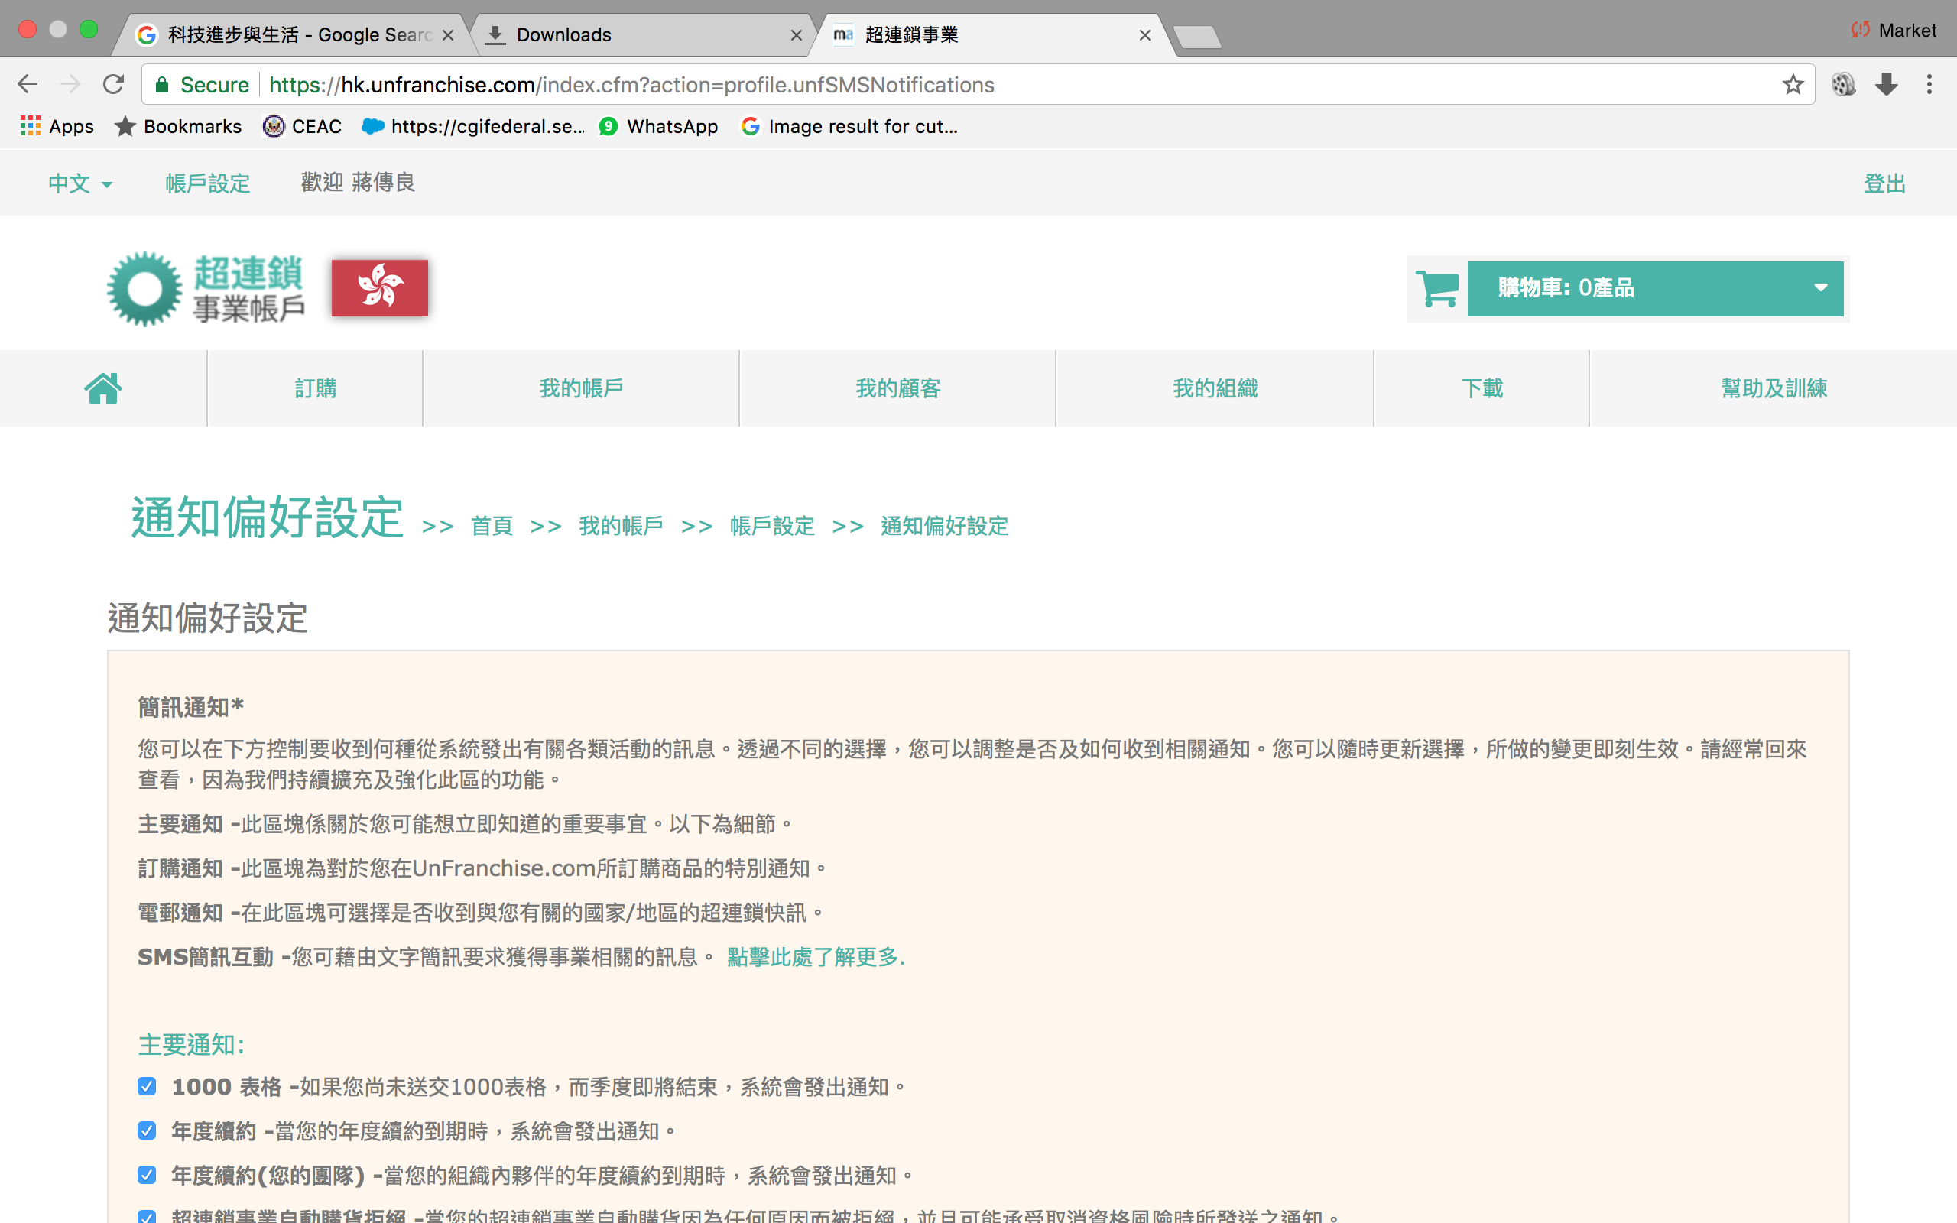

Slide 30
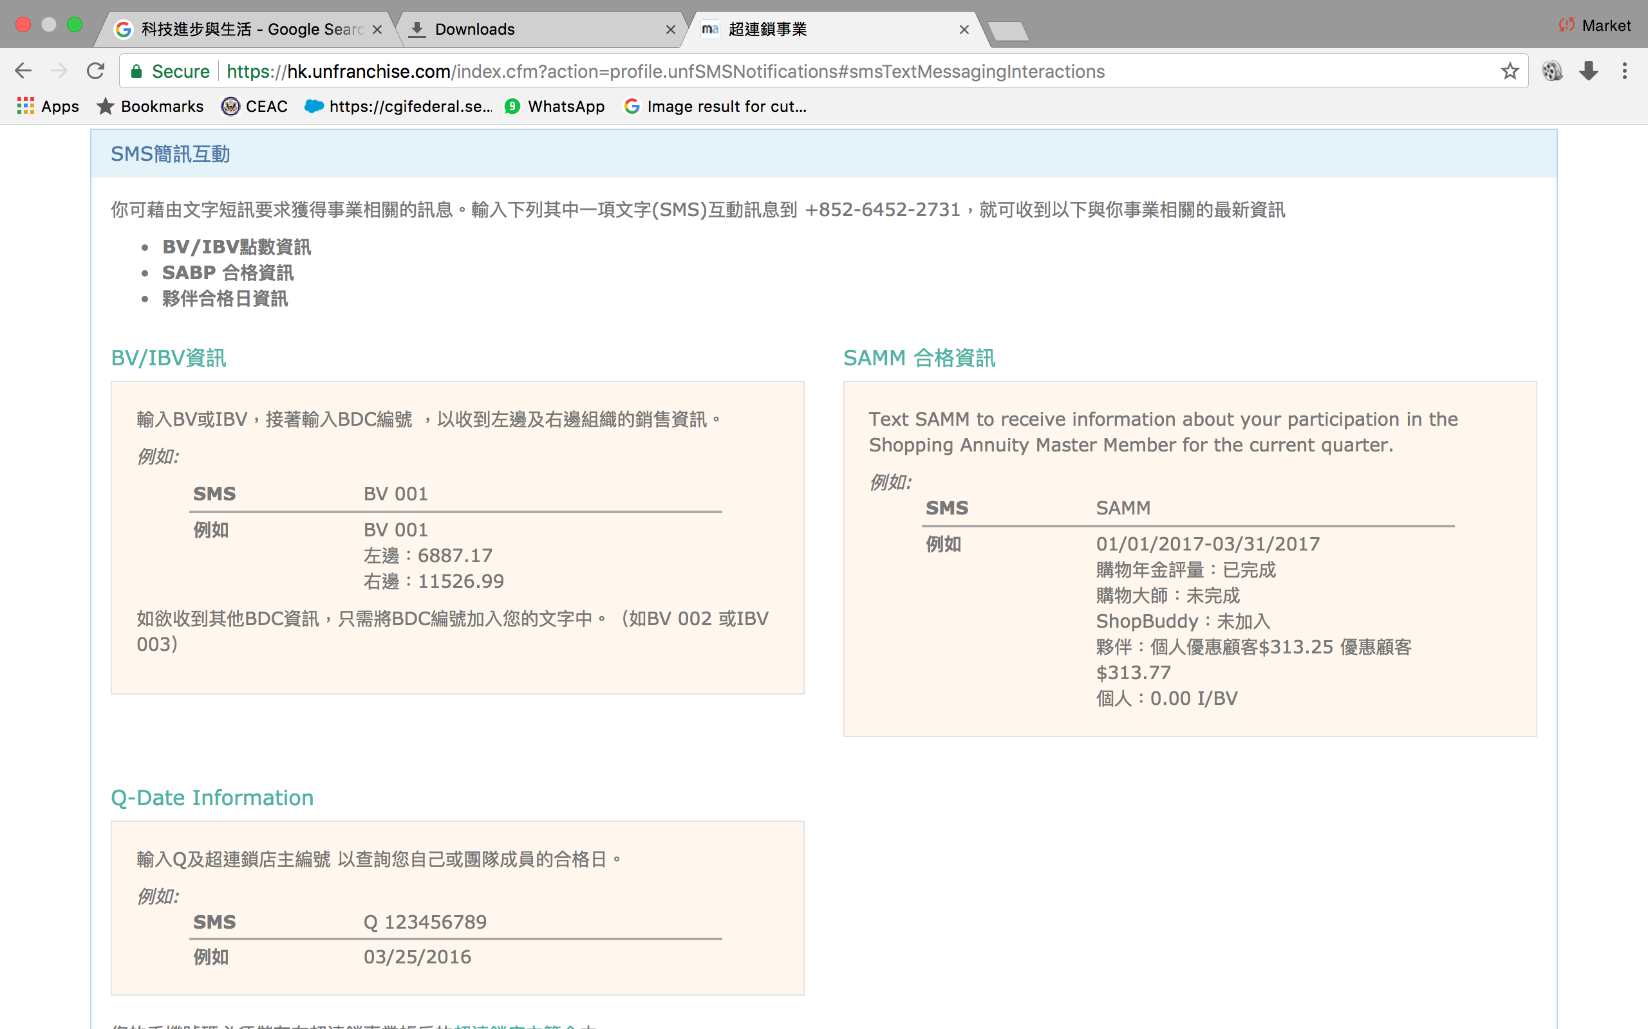

Slide 31
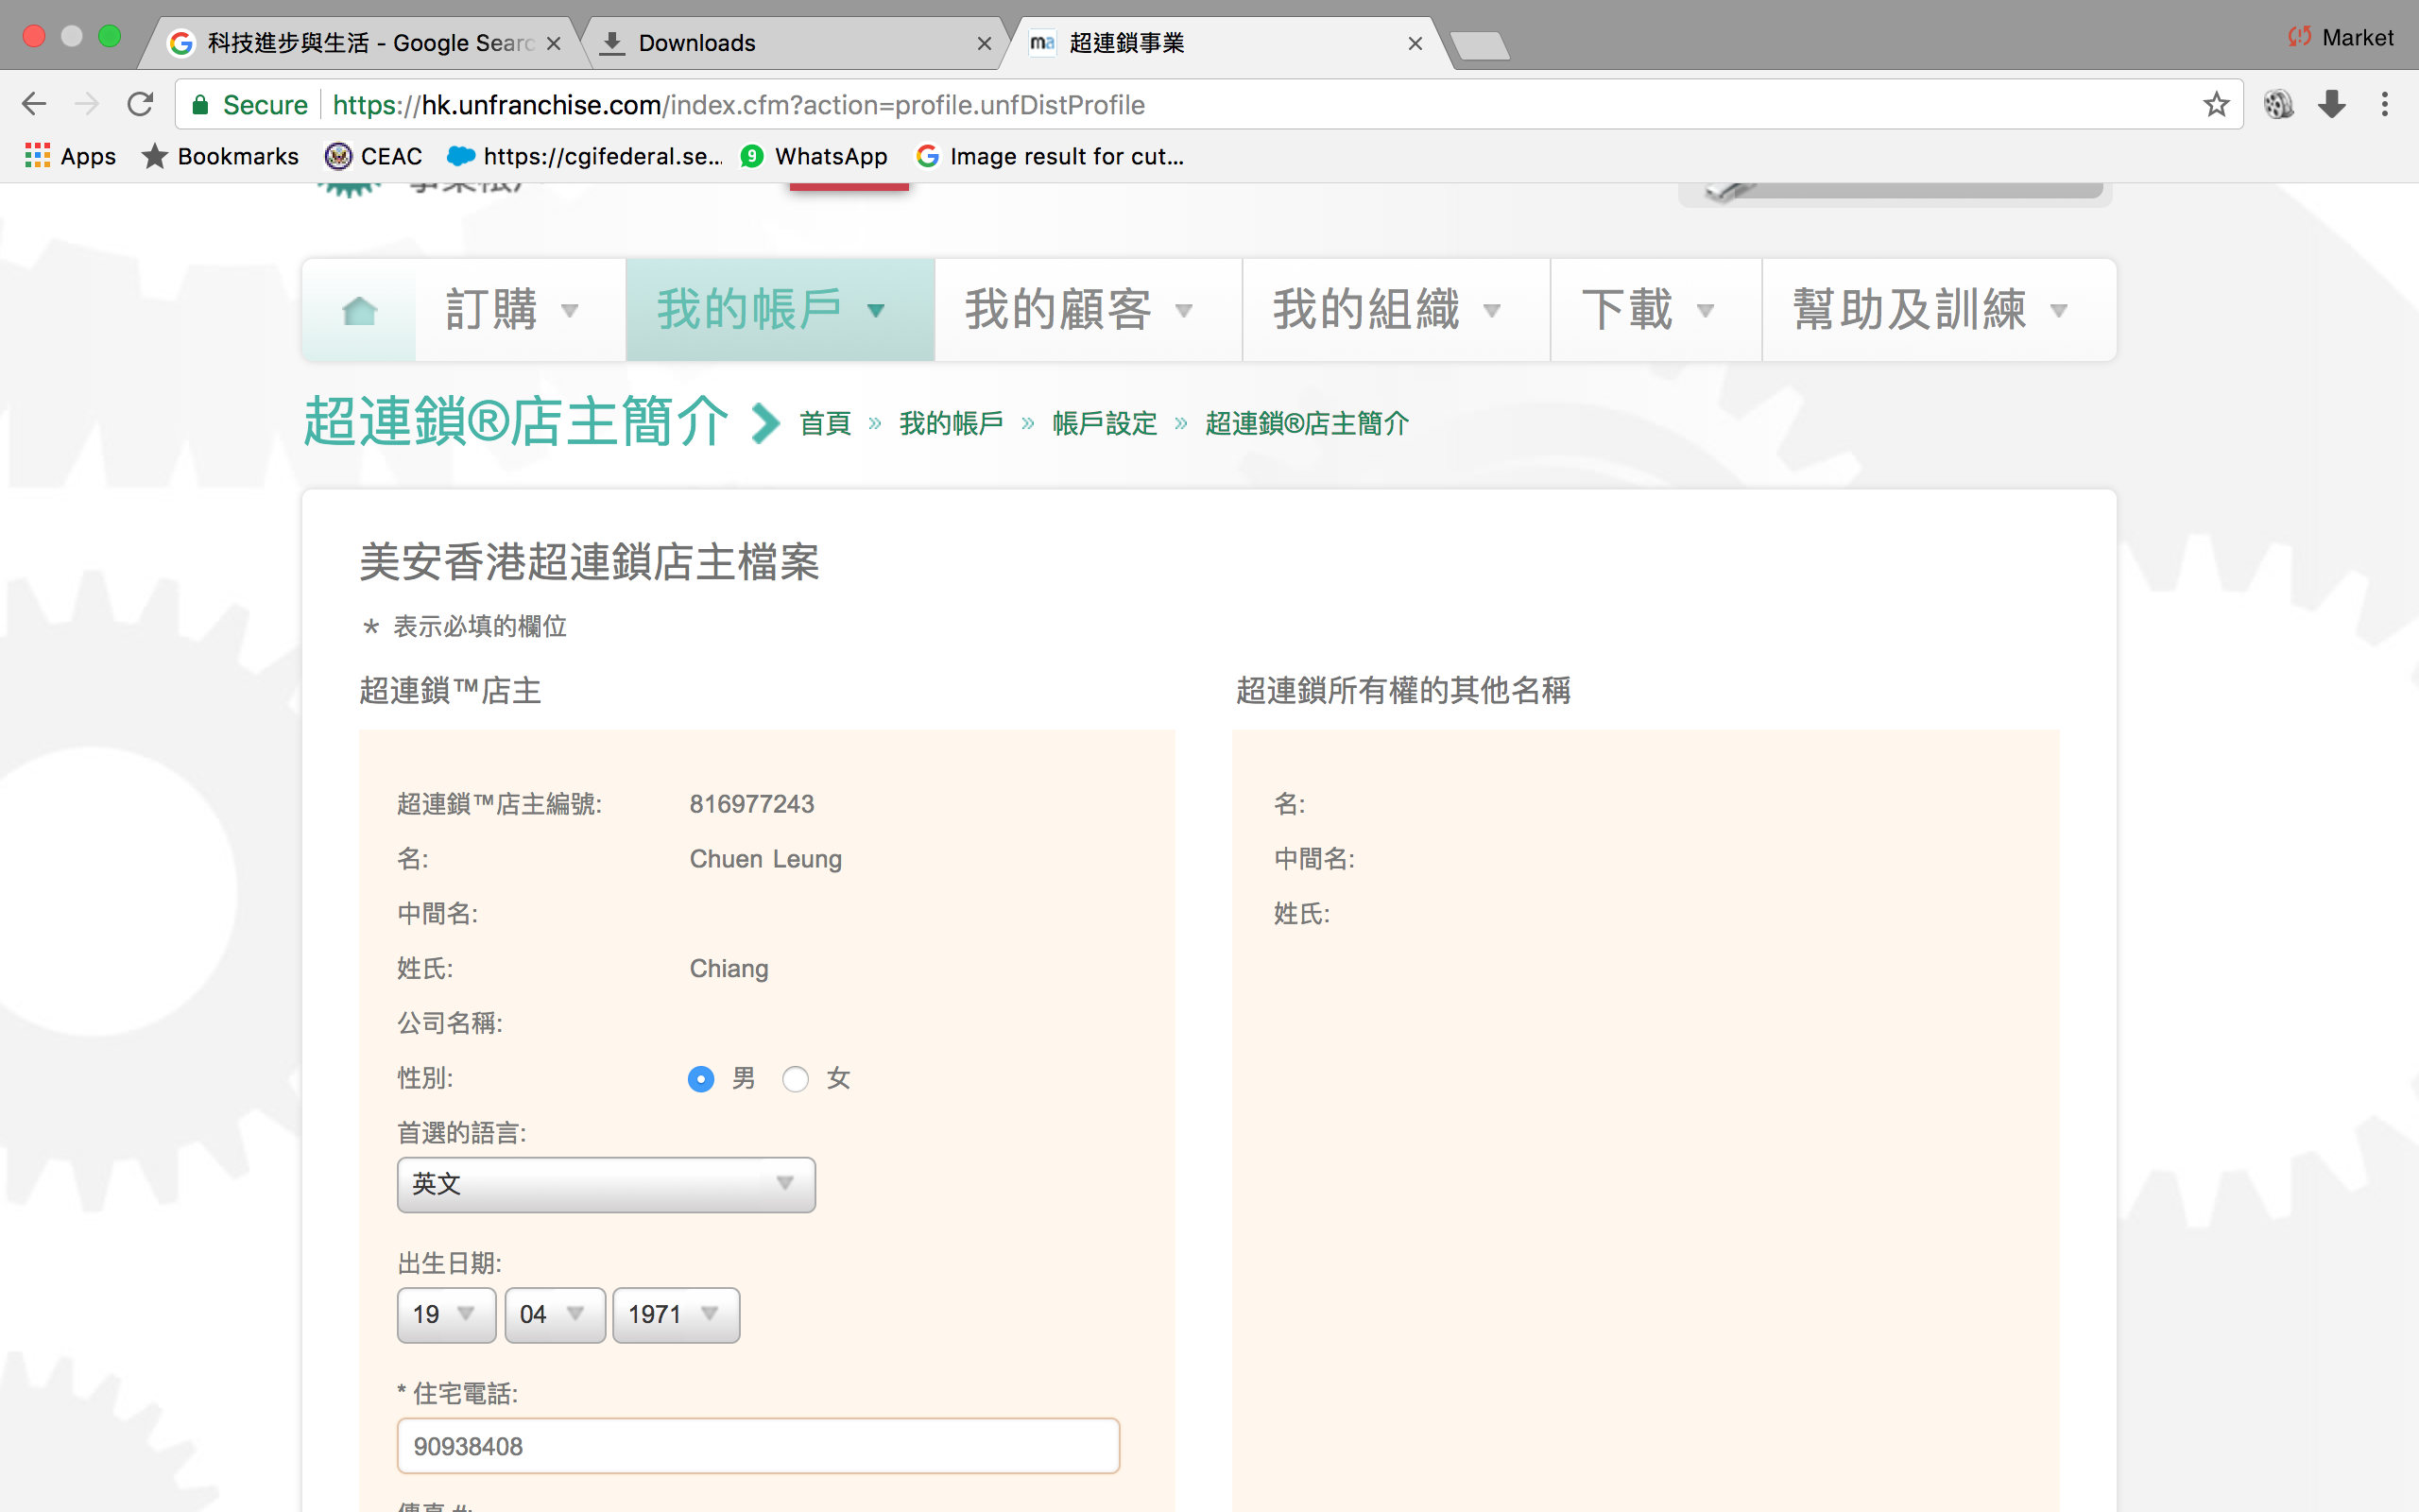
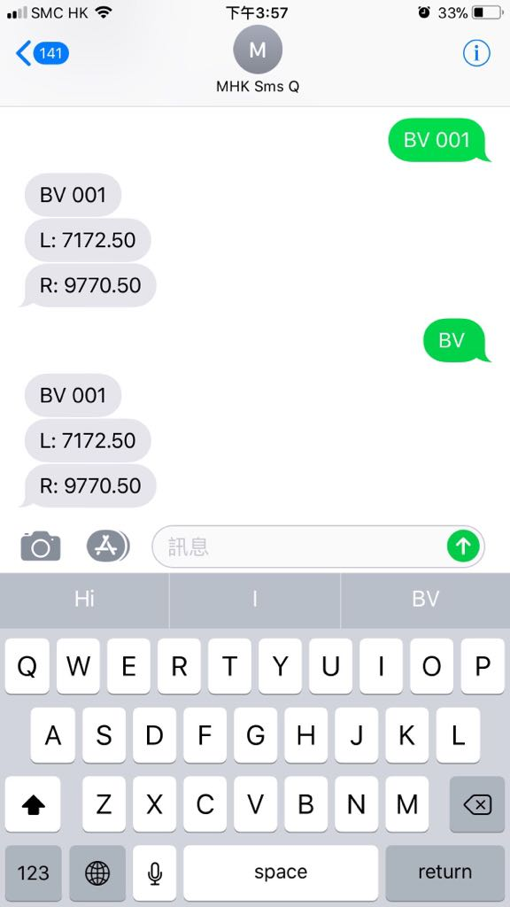

Slide 32
New Functions
Coming soon
Pick your desired
delivery date and time

Slide 33
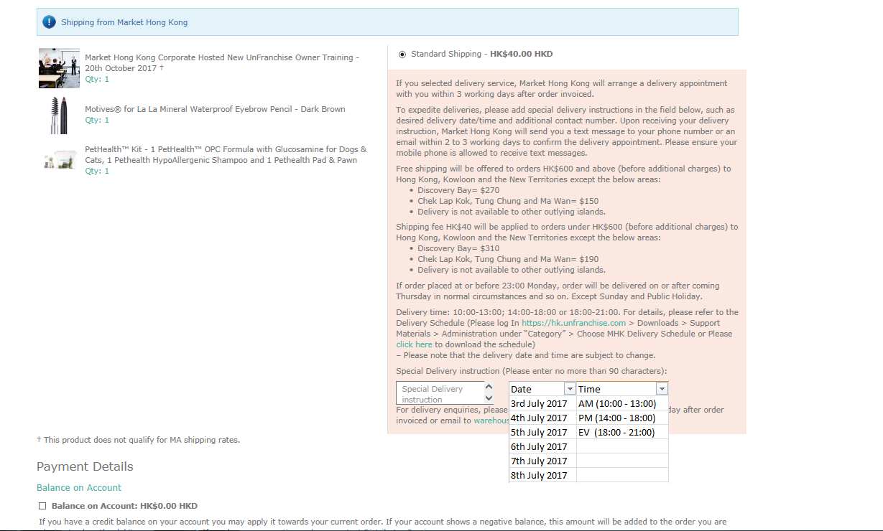

Slide 34



Slide 35
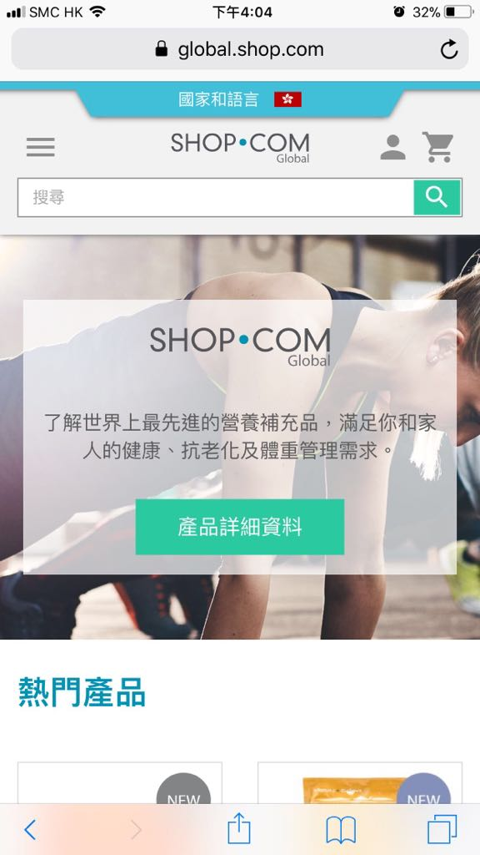
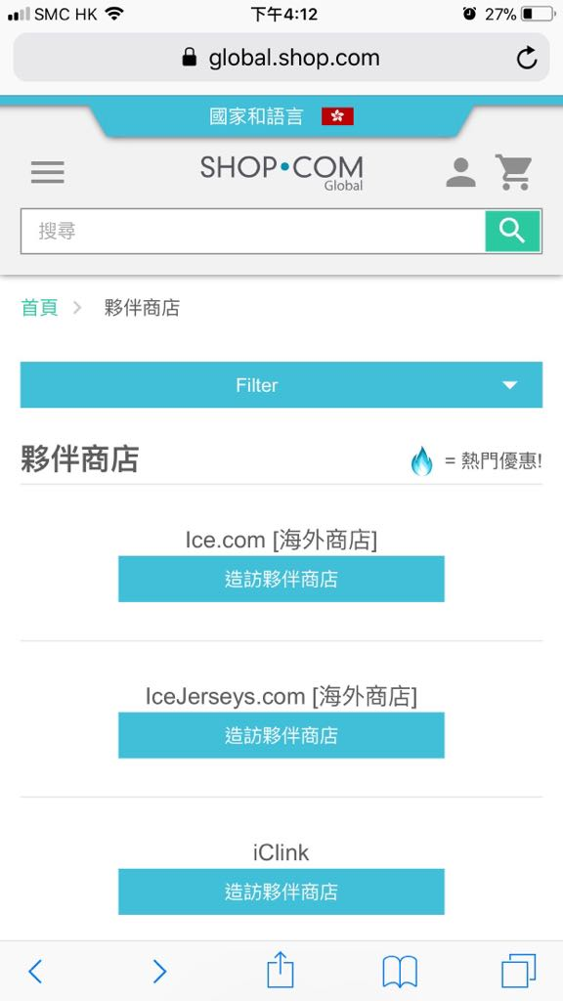

Slide 36



Slide 37
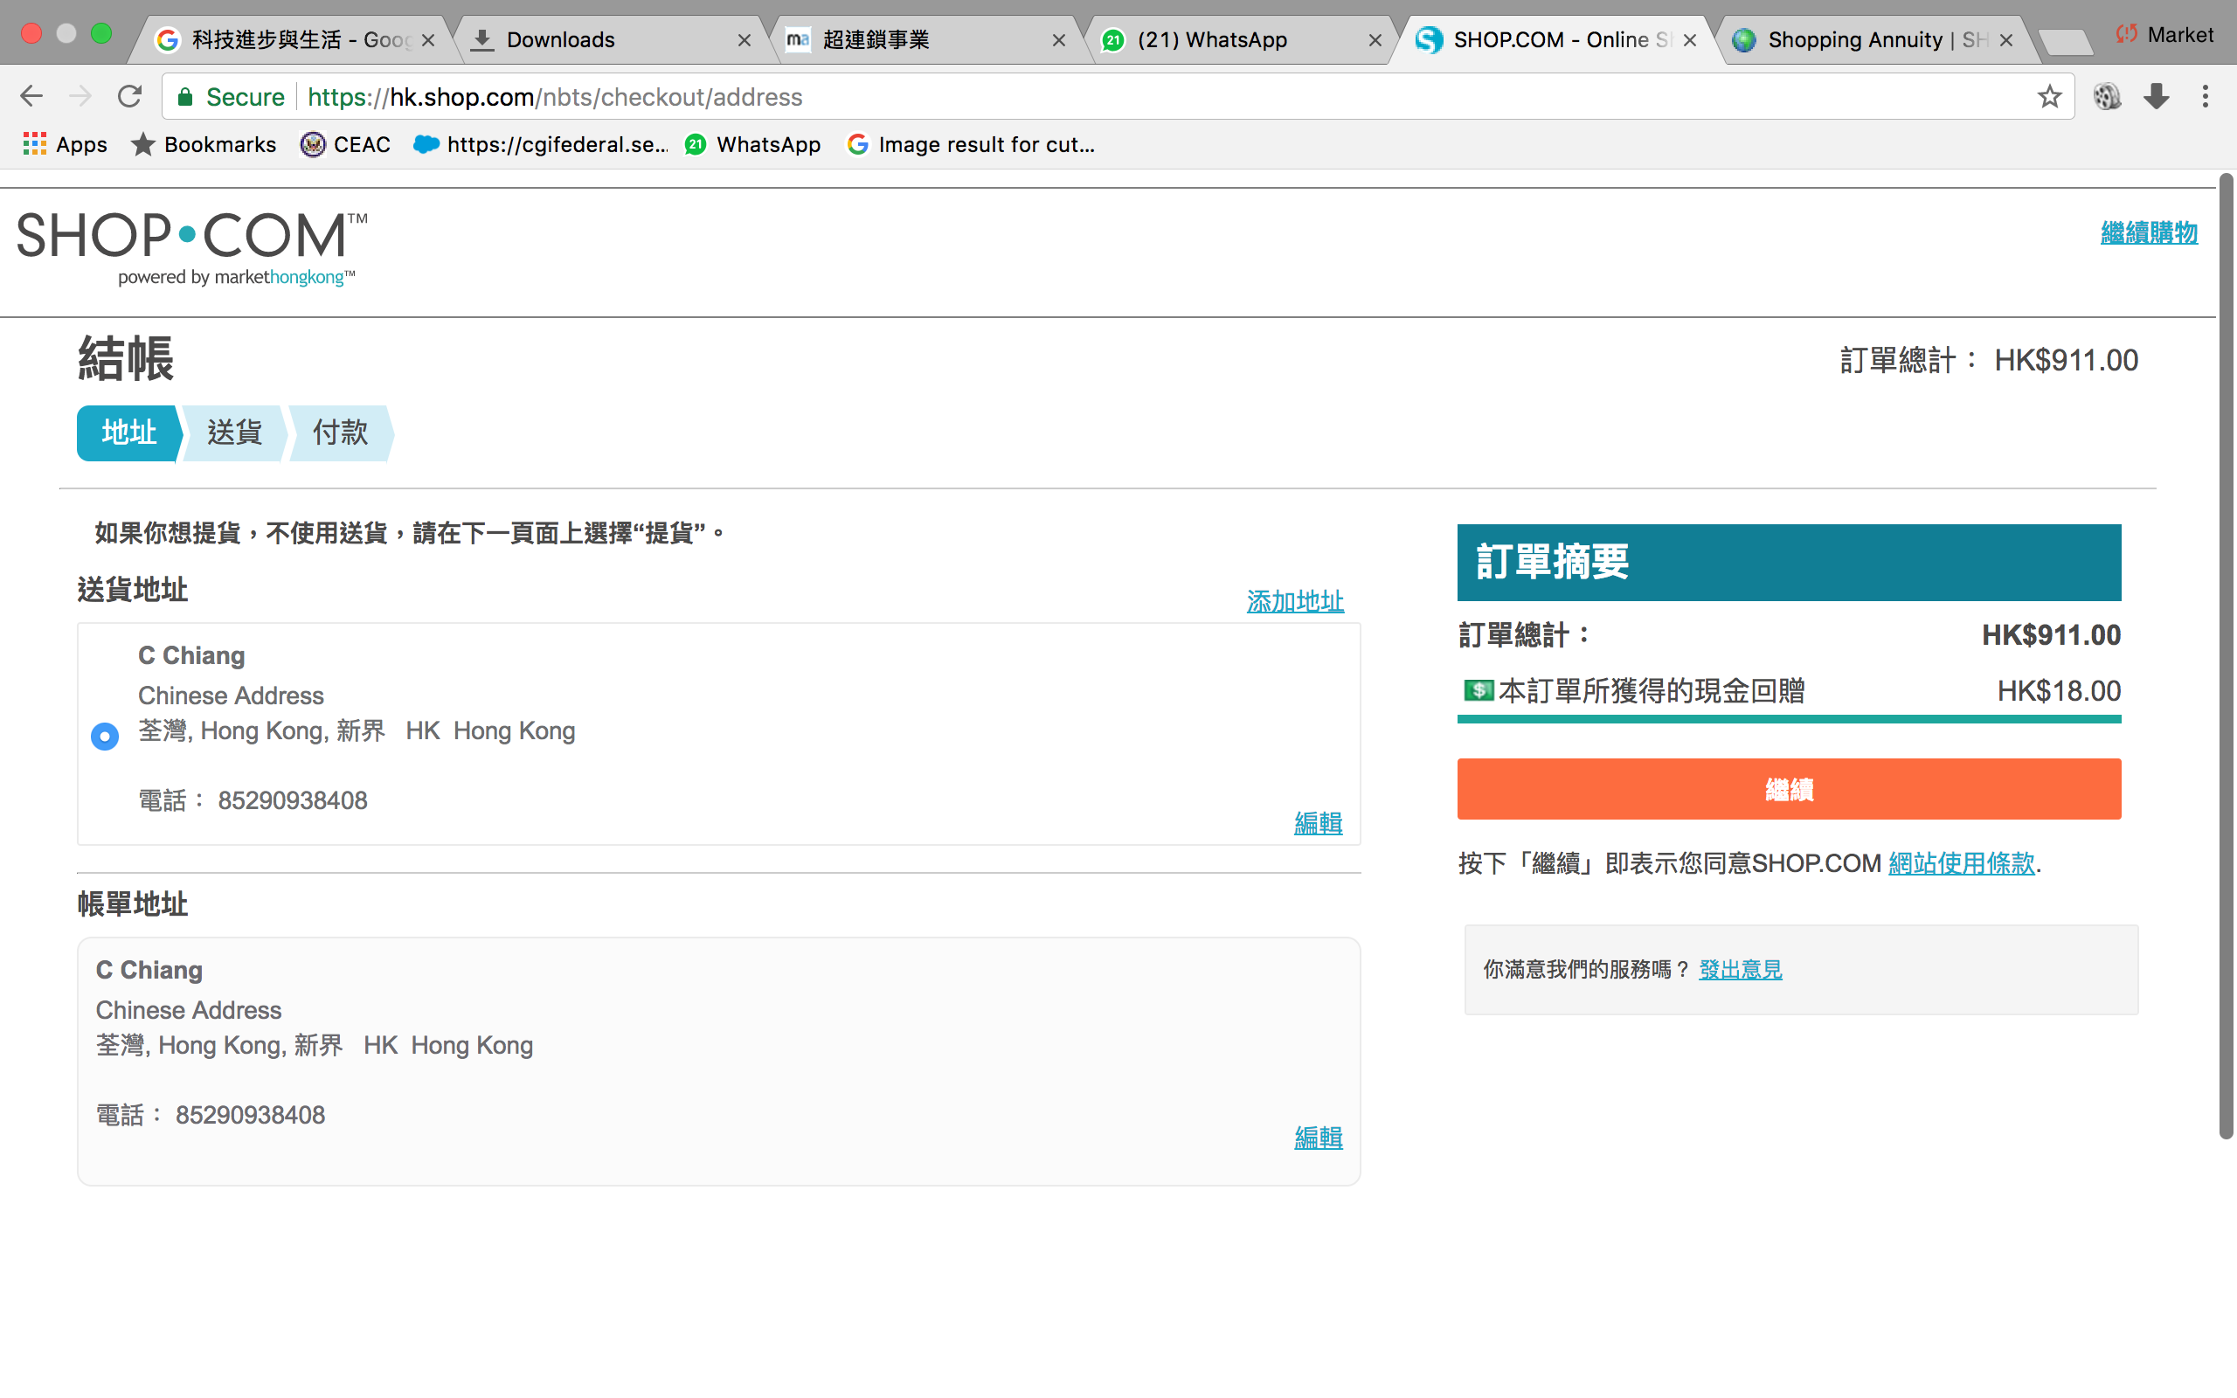

Slide 38
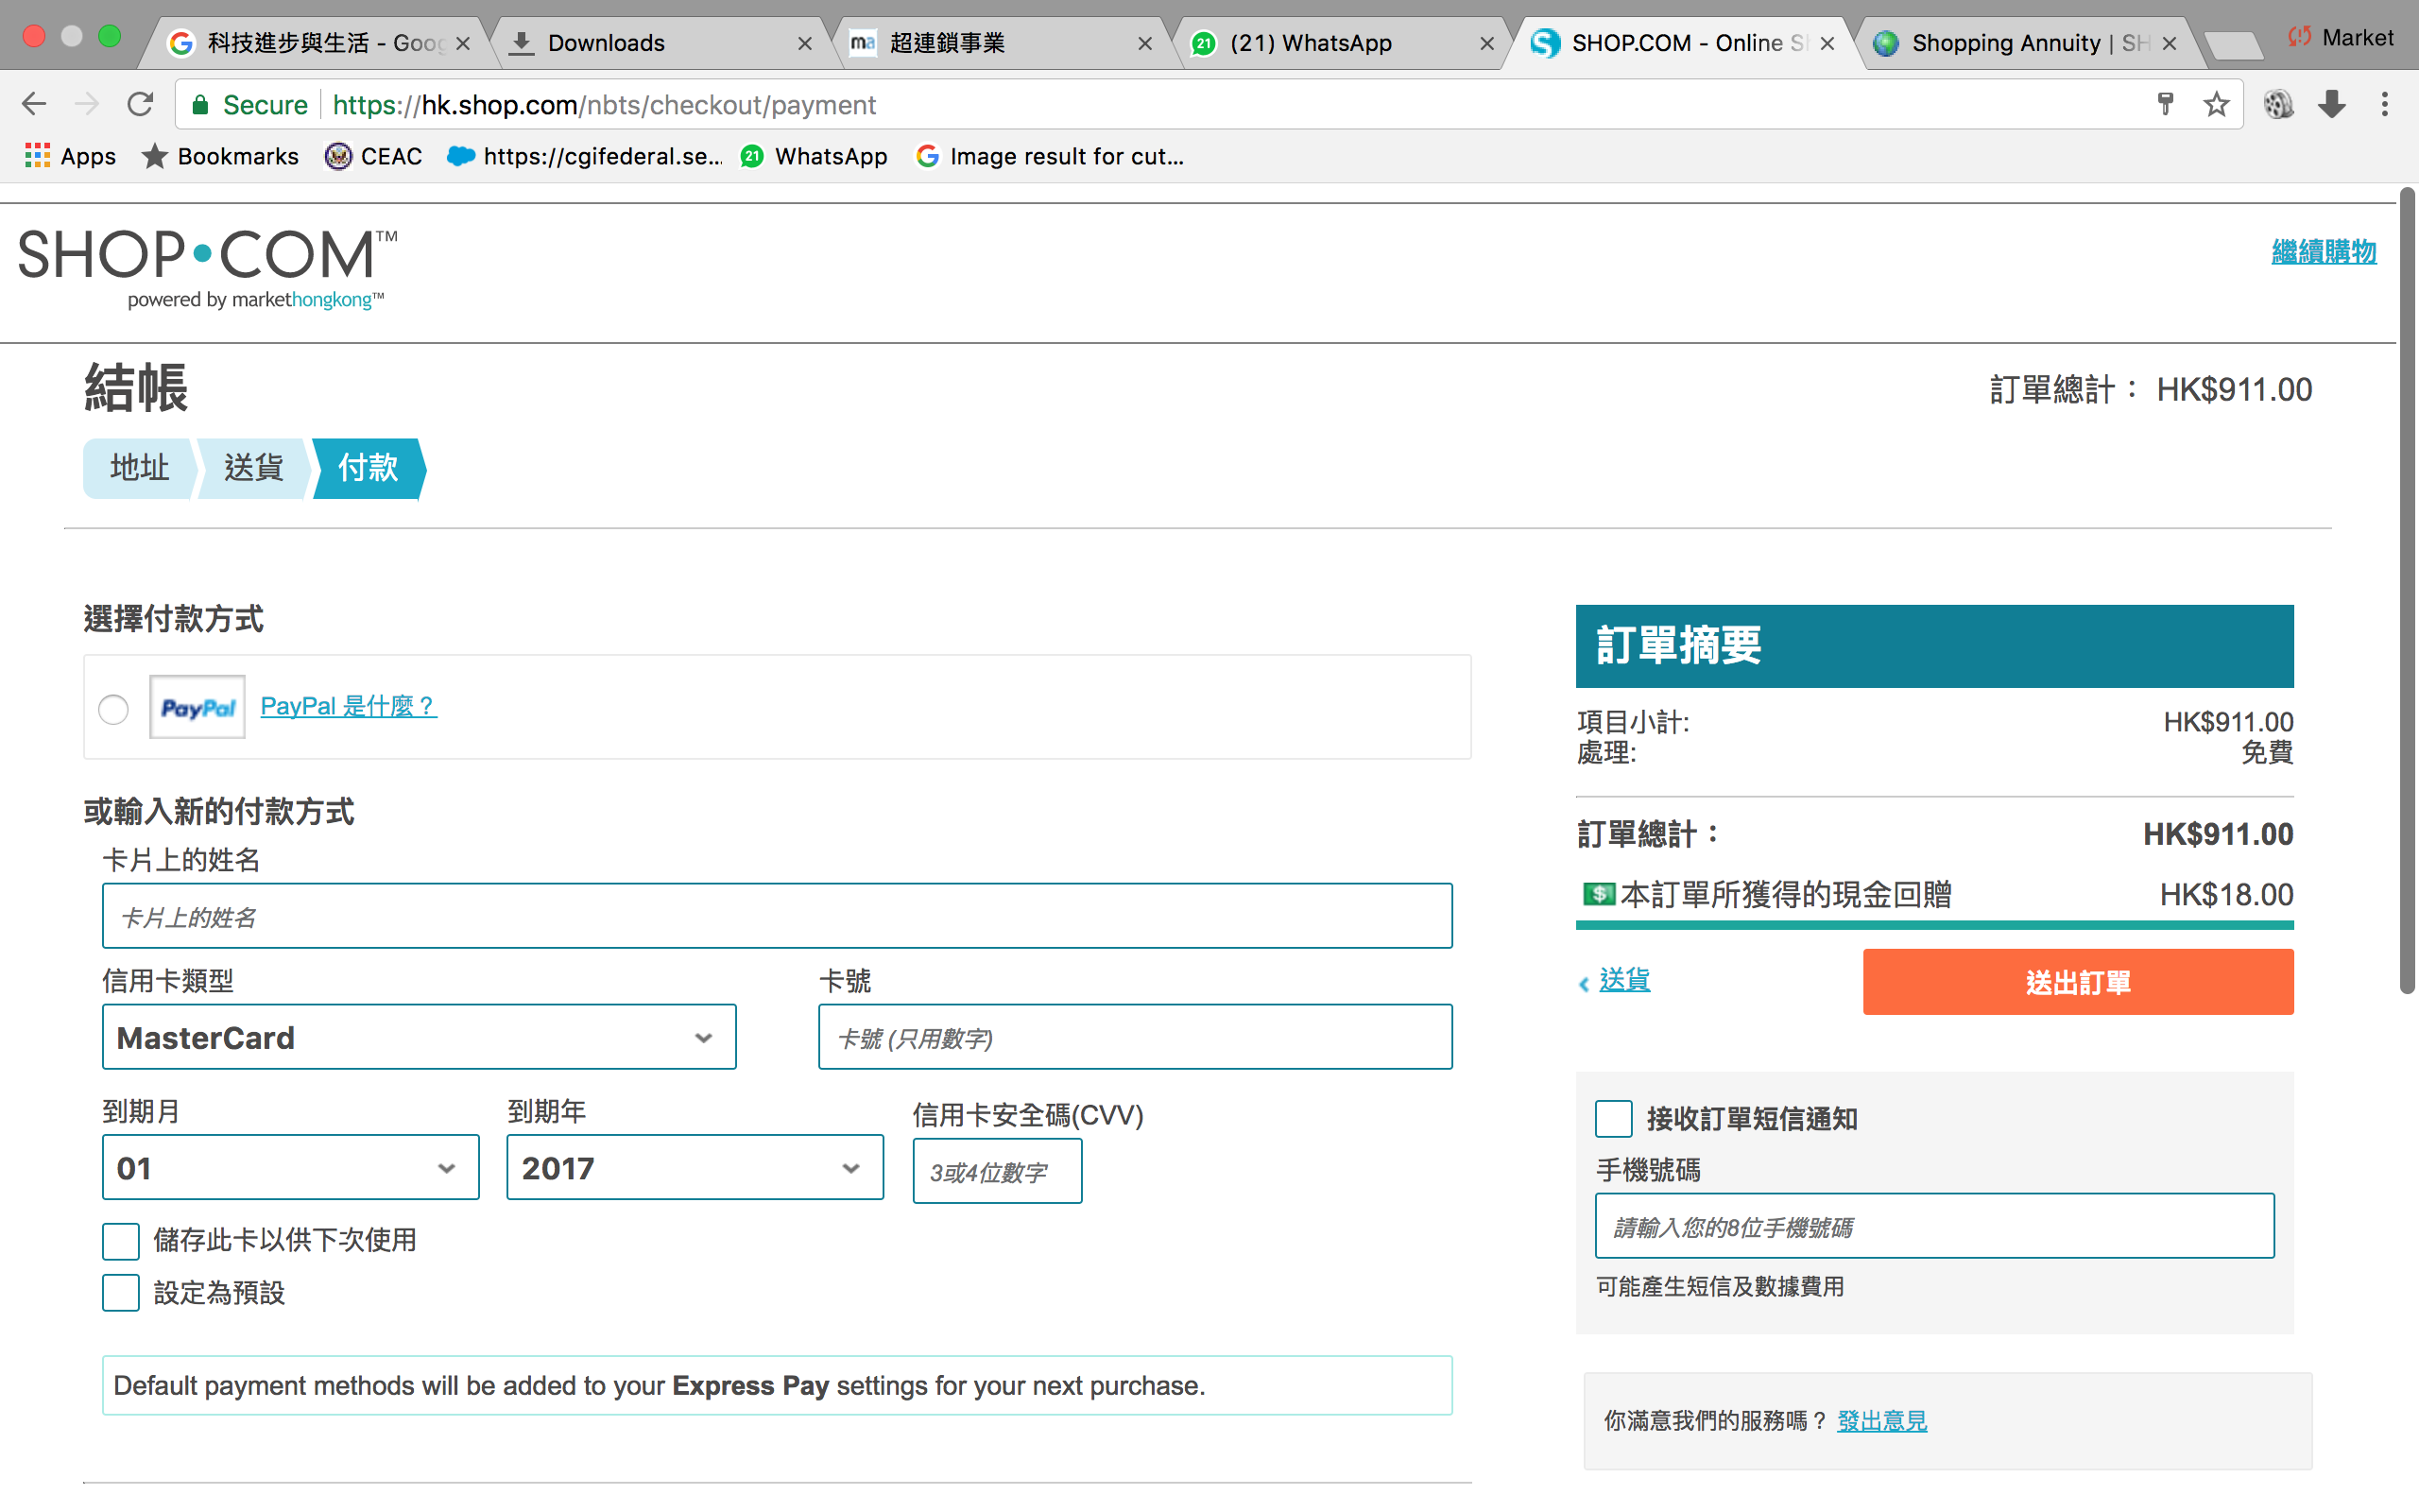

Slide 39
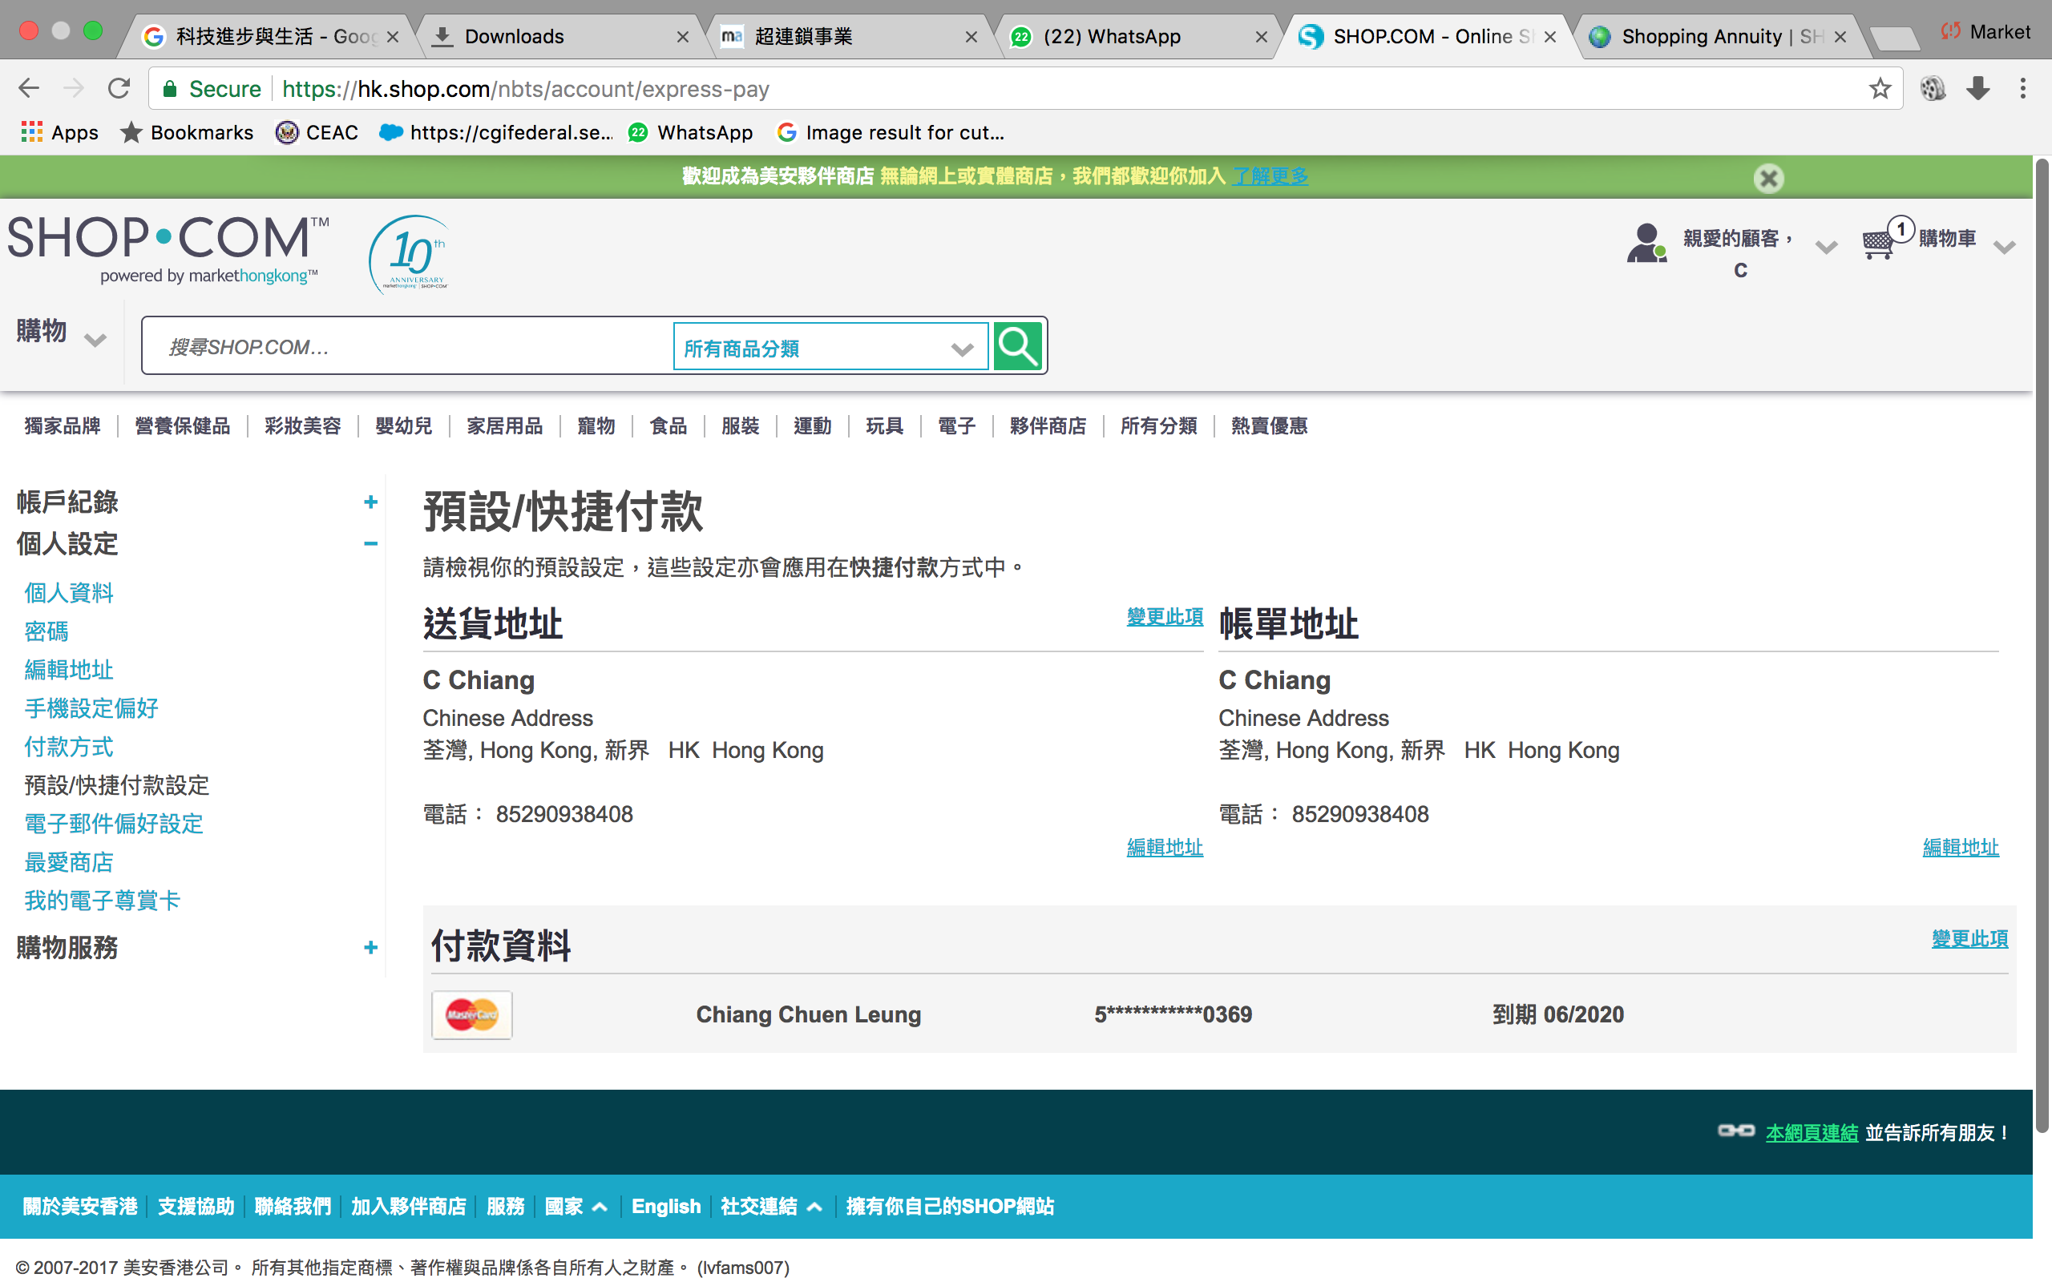

Slide 40
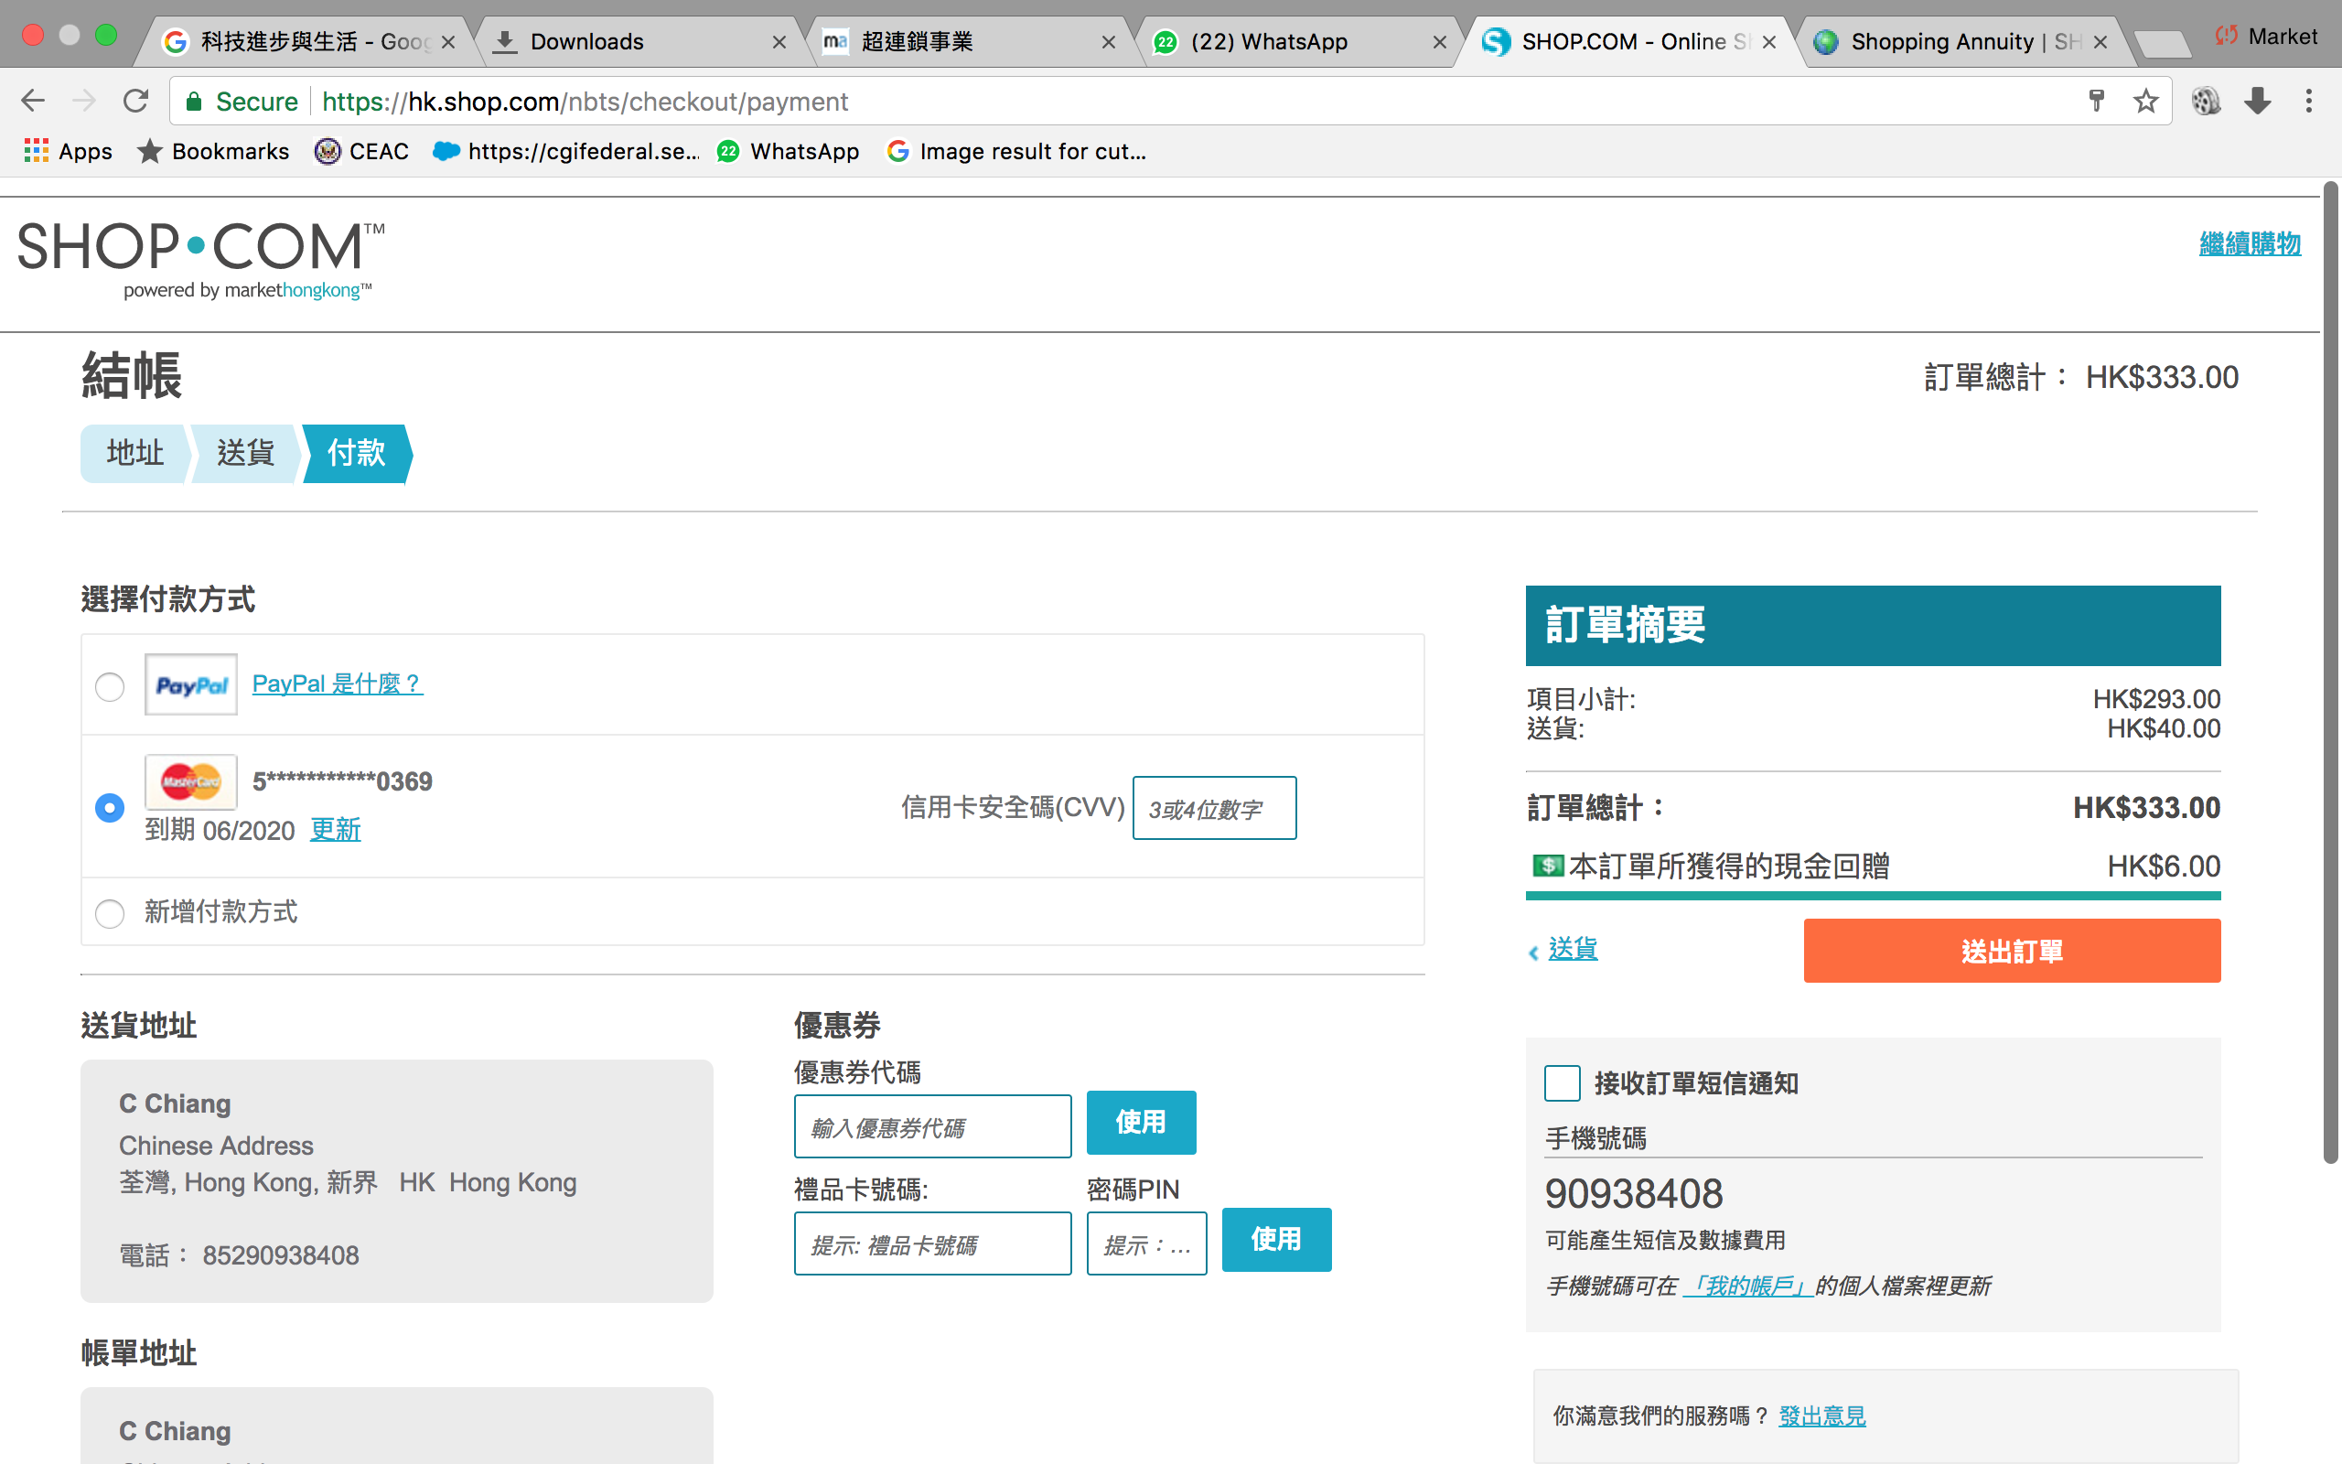

Slide 41


Knowledge alters your fate. You must first obtain it before you can use it.
Tools provided by shop.com allows you to better implement 1-to-1 marketing.
We must learn them before using them.
Notes:
Shopcom 所提供的工具越來越方便優惠客戶方便店主，我們是否在認真的使用各種工具好好的服務好客戶做好 1 對 1 呢？

Slide 42
[
]
THE UNFRANCHISE™ BUSINESS
Copyright © 2017 Market America Worldwide

